Slide 1

ALY 3510 AI Foundations:
An Interdisciplinary Approach
Bonus Lecture:
Advanced Subjects/Notions/Concepts in AI
Session/Section: Fall 2026
Time: Monday 5:50-8:30 PM
Instructor: Vladimir Shapiro

Slide 2

Bonus Lecture:
Advanced Subjects in AI
Exploring the cutting-edge concepts shaping modern artificial intelligence

Slide 3
Advanced Subjects/Notions/Concepts in AI
23Topics Covered
1. Agentic AI
2. Scaling Laws
3. Vector Databases
4. RAG (Retrieval-Augmented Generation)
5. Context Window
6. Knowledge Cutoff Date
7. Chain of Thought (CoT)
8. Reasoning/Thinking Models
9. Zero/One/Multi-shot Learning
10. Meta-Learning
11. RLHF (Reinforcement Learning from Human Feedback)
12. Sycophancy
13. Model Context Protocol (MCP)
14. Latent Space
15. Jailbroken Models
16. Vibe Coding
17. Causal AI
18. Multimodal AI
19. Hallucinations
20. Mixture-of-Experts (MoE)
21. Emergent Capabilities in AI
22. Fine-Tuning vs. Prompting
23. Jev

Slide 4
Part 1
Agentic AI

Slide 5
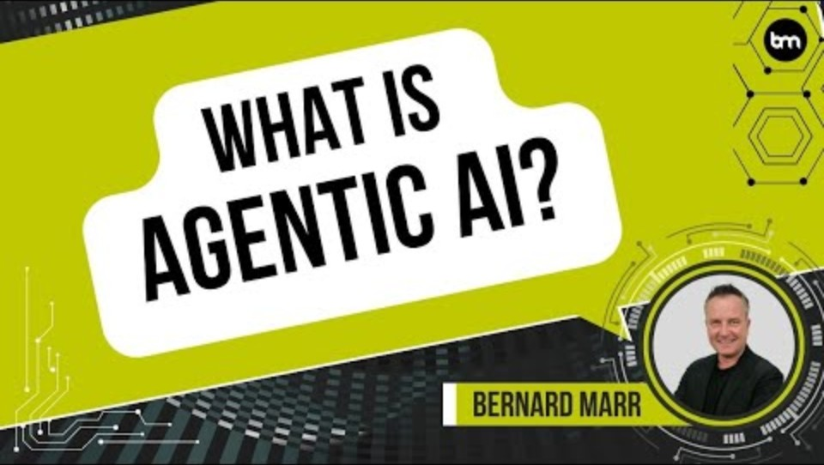
Agentic AI - Video (3:51)
Bernard Marr explains the fundamentals of Agentic AI
https://www.youtube.com/watch?v=-pqzyvRp3Tc

Slide 6
Core Definition & Key Ideas
Core Definition & Key Ideas
Definition:
Agentic AI refers to AI systems that can autonomously pursue goals, make decisions, and take actions with minimal human intervention. Unlike traditional AI that responds to specific prompts, agentic AI can plan, reason, and execute complex multi-step tasks independently.
Traditional AI vs. Agentic AI
Traditional AI
Agentic AI
• Requires prompts from humans
• Pattern recognition & prediction
• Classification within structured datasets
• Reactive: Question → Answer
• Takes action to achieve defined outcomes
• Perceives environment & reasons
• Executes actions & learns from outcomes
• Proactive: Goal → Plan → Execute → Adapt
https://share.google/images/XmCfRompQuohcMdTi

Slide 7
Building Blocks & Components
🧠
💾
🔧
Brain (LLM)
Memory
Tools
Planning and reasoning capabilities powered by large language models
Stores intermediate results, context, and learned information (short & long-term)
Calendar, calculator, code interpreter, search, APIs, and more
Planning Capabilities
Reflection
Self-criticism
Chain of Thought
Subgoal Decomposition
→ Action Execution
https://share.google/images/kkXOjoMTJ97IU5fhe

Slide 8
Fundamental Characteristics
1
Autonomy:
Operates independently once given objectives
2
Goal-directed:
Pursues specific outcomes through planning and reasoning
3
Tool use:
Interacts with external systems, APIs, and software tools
4
Adaptive:
Adjusts strategies based on feedback and changing conditions
5
Persistence:
Maintains context and works toward goals over extended periods
Key Distinction: Traditional AI is reactive (question → answer), while Agentic AI is proactive (goal → plan → execute → adapt)
https://share.google/images/kkXOjoMTJ97IU5fhe

Slide 9
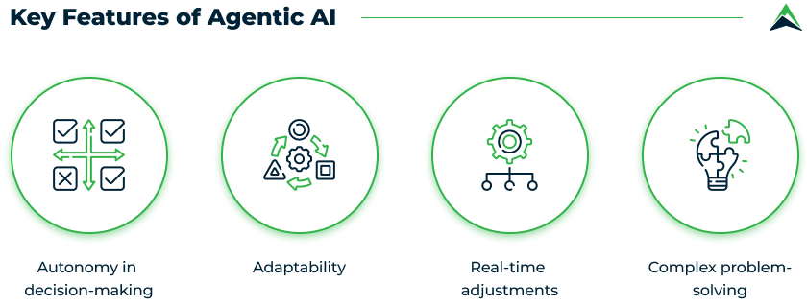
Real-World Applications & Capabilities
Software Development
Personal Assistance
AI agents that write, debug, and deploy code autonomously
AI that manages calendars, emails, and complex task coordination
Research & Analysis
Scientific Discovery
Systems that conduct literature reviews, gather data, and synthesize findings
Autonomous experimentation and hypothesis generation
Business Operations
Automated customer service, supply chain optimization, workflow management
What Makes This Possible:
LLMs with reasoning • Tool/API integration • RLHF training • Advanced planning algorithms
https://share.google/images/fxw26eTY2aBLaFTHN
https://share.google/images/kkXOjoMTJ97IU5fhe

Slide 10
Challenges, Risks & Future Expectations
Critical Challenges
Future Expectations (5-10 Years)
Reliability & Safety: Preventing harmful actions
Alignment Problem: Keeping goals aligned with human values
Accountability: Determining responsibility for mistakes
Control & Oversight: Maintaining meaningful human supervision
Hallucination: Agents acting on false information
Increased Integration: Standard in professional
workflows
Collaborative Intelligence: Human-AI teams
Economic Impact: Productivity gains + workforce changes
Regulatory Evolution: New governance frameworks
Capability Expansion: From narrow to general- purpose
Key Insight: Agentic AI represents a paradigm shift from AI as a tool to AI as a collaborator
https://share.google/images/kkXOjoMTJ97IU5fhe

Slide 11
Part 2
Scaling Laws in AI

Slide 12
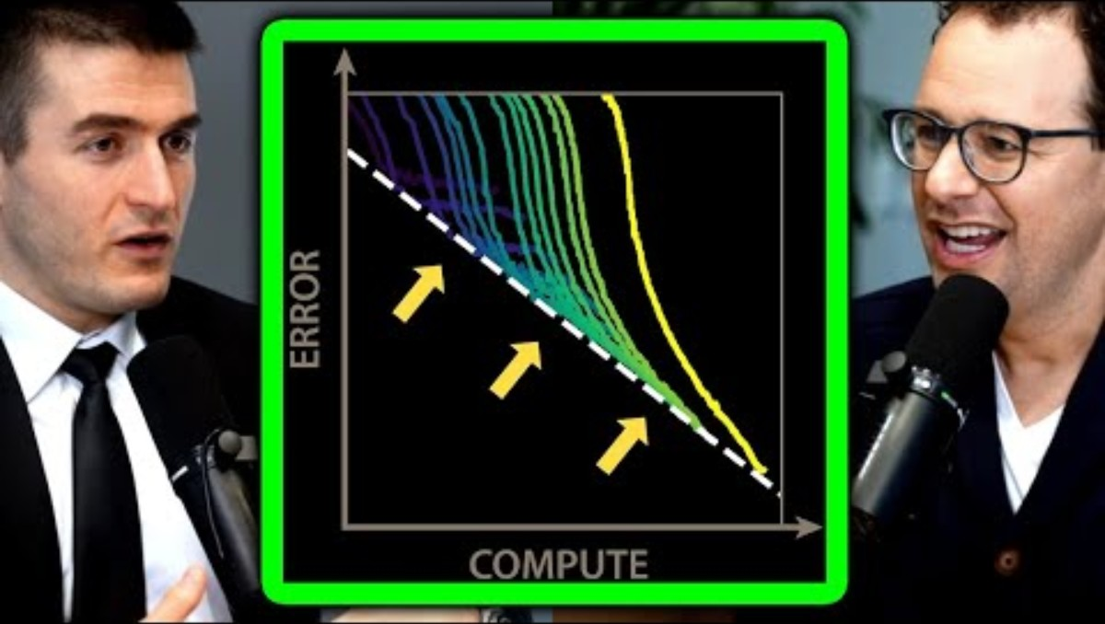
Scaling Laws in AI - Video (watch first 4-5min)
Dario Amodei (Anthropic) explains the concept of Scaling Laws in AI
https://www.youtube.com/watch?v=GrloGdp5wdc

Slide 13
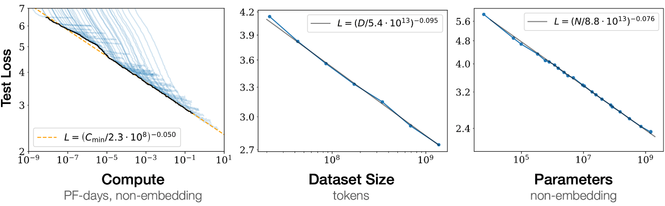
Overview & Core Concepts
Definition:
Scaling laws describe how AI model performance improves predictably as we increase resources (data, compute, parameters). Error decreases smoothly following power-law.
Core Variables:
Model Size
Dataset Size
Compute
Number of parameters
Training examples
FLOPs used in training
10B → 100B → 1T+
Tokens processed
GPU hours / cost
Takeaway: Larger models + more data → better performance, but with diminishing returns
https://share.google/images/kkXOjoMTJ97IU5fhe
https://share.google/images/24UXZjiAzX9guOQc1

Slide 14
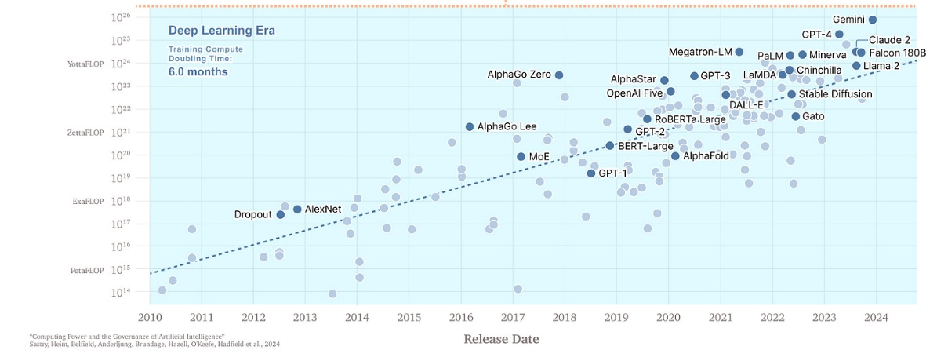
Strategic Impact & Implications
Predictive Power:
Forecast future model performance without training them
Resource Allocation:
Guide trade-offs between data, model size, and compute
Benchmarking:
Scientific framework to compare models systematically
Strategic Roadmap:
Informs building of frontier models (GPT-4, GPT-5, etc.)
Big Picture: Scaling laws act as the "Moore's Law" of AI progress — they help identify when scaling saturates and motivates innovation beyond brute force (e.g., new architectures, efficiency gains).
https://share.google/images/kkXOjoMTJ97IU5fhe

Slide 15
Part 3
Vector Databases in AI

Slide 16
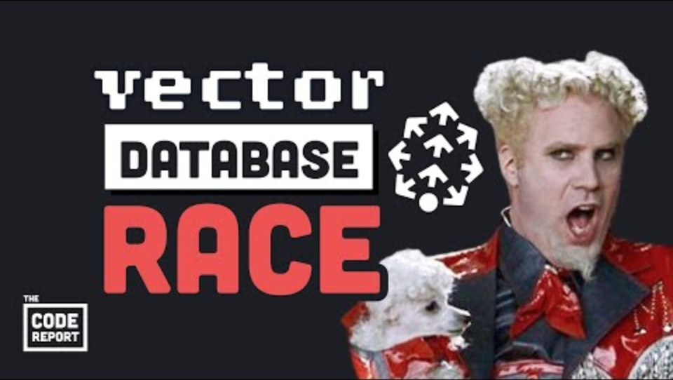
Vector Databases in AI - Video (3:21)
Fireship explains vector databases and their role in AI
https://www.youtube.com/watch?v=klTvEwg3oJ4

Slide 17
What They Are & Why AI Needs Them
Core Definition:
Vector databases are specialized storage systems designed to efficiently store, index, and search high-dimensional numerical representations (vectors) of data. In AI contexts, these vectors are "embeddings" — numerical representations of text, images, audio, or other data that capture semantic meaning.
The Key Insight:
Similar things have similar vector representations
"Cat" and "kitten"
→
vectors close together in space
"Cat" and "airplane"
→
vectors far apart
This works for any data type: text, images, code, audio
https://share.google/images/kkXOjoMTJ97IU5fhe

Slide 18
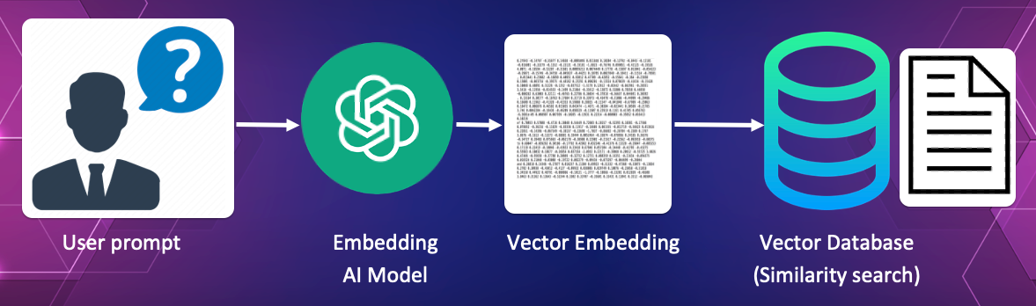
Why Traditional Databases Fall Short
SQL/NoSQL Databases
Vector Databases
Search by exact matches or predefined criteria
"Find documents WHERE title = 'climate'"
Search by meaning, context, similarity
"Find documents about climate change" (works even without exact phrase)
Core Capabilities:
Semantic Search:
Find similar items based on meaning, not keywords
Nearest Neighbor:
Quickly find the most similar vectors among millions
Hybrid Search:
Combine vector similarity with traditional filters (date, tags)
https://share.google/images/kkXOjoMTJ97IU5fhe
https://share.google/images/J95G3xrZDLQGXeJwk

Slide 19
Applications & Challenges
Current Applications in AI
Critical Problems & Limitations
RAG: LLMs accessing external knowledge to reduce hallucinations
Semantic Memory: Storing/retrieving past interactions for AI agents
Multimodal Search: Finding images from text descriptions
Personalization: Netflix/Spotify recommendations
Enterprise AI: Searching internal docs by meaning
Curse of Dimensionality: Performance degrades as dimensions increase
Storage & Compute: Vectors are large; similarity calculations expensive
Embedding Quality: Garbage in, garbage out
Update Complexity: Changing embedding models = re-index everything
Approximate vs Exact: Fast search trades accuracy

Slide 20
Part 4:
RAG (Retrieval-Augmented Generation)

Slide 21
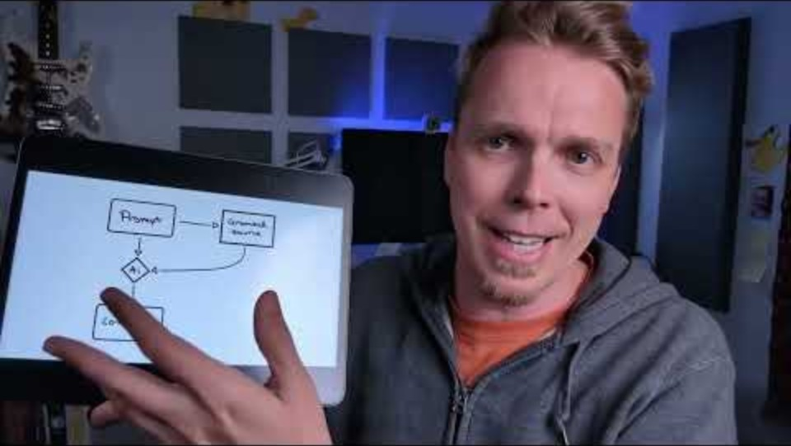
RAG (Retrieval-Augmented Generation) - Video (2:56)
Understanding how RAG enhances LLM capabilities
https://www.youtube.com/watch?v=tKPSmn-urB4

Slide 22
Giving AI Access to External Knowledge
Core Definition:
RAG is a technique that enhances Large Language Models by allowing them to retrieve and use external information during text generation, rather than relying solely on knowledge "frozen" during training.
The Key Innovation:
Traditional LLM: General knowledge only
RAG-Enhanced LLM: Specialized, current knowledge
Core Components:
Knowledge Base
Embedding Model
Vector Database
LLM
Your documents, databases, PDFs
Converts text to vectors
Stores and searches embeddings
Synthesizes retrieved information

Slide 23
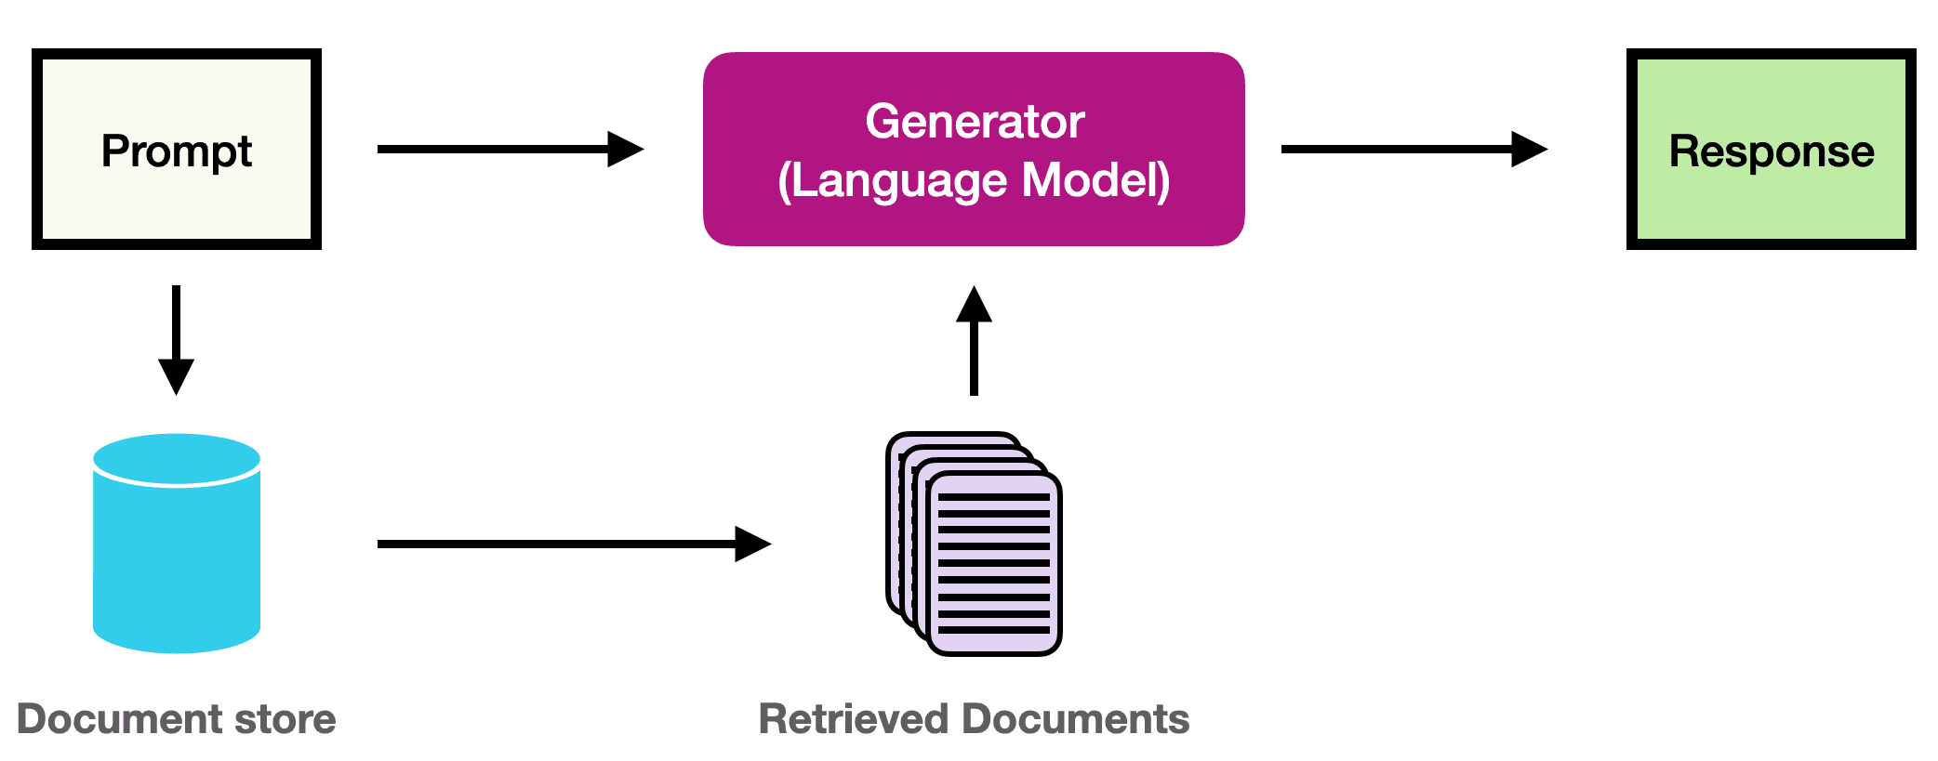
How RAG Works (Conceptual Flow)
1
User asks a question
"What's our company's remote work policy?"
↓
2
Retrieve relevant documents
Search knowledge base for policy documents
↓
3
Augment the prompt
Inject retrieved docs into LLM's context
↓
4
Generate informed response
LLM answers using both training + retrieved facts
https://share.google/images/kkXOjoMTJ97IU5fhe
https://share.google/images/yWo1UsHP046ppe4vr

Slide 24
Problems Solved & Applications
Problems RAG Solves
Current Applications
Knowledge Cutoff: LLMs only know
training data (often months old)
Hallucination: LLMs make up facts when uncertain
Black Box: Can't verify what LLM "knows“
Specialized Domains: Generic models lack org-specific knowledge
Enterprise AI Assistants
Customer Support Chatbots
Legal/Medical AI (citing sources)
Academic Research Assistants
Personal AI (ChatGPT web search)
Code Generation (GitHub Copilot)
https://share.google/images/kkXOjoMTJ97IU5fhe

Slide 25
Challenges & Key Insights
Critical Challenges:
Context Window Limits:
Can only inject limited information
Information Conflicts:
Retrieved docs may contradict each other
Retrieval Quality:
Wrong documents = wrong answers
Cost:
Every retrieval + longer context = more API cost
Latency:
Search adds delay to responses
Security:
Ensuring users only access authorized docs
Key Insight: Closed-Book vs. Open-Book Exam
RAG gives AI the ability to cite sources, stay current, and acknowledge what it doesn't know — making AI systems more trustworthy, verifiable, and useful for real-world applications where accuracy and timeliness are crucial.
https://share.google/images/kkXOjoMTJ97IU5fhe

Slide 26
Part 5
Context Window in AI

Slide 27
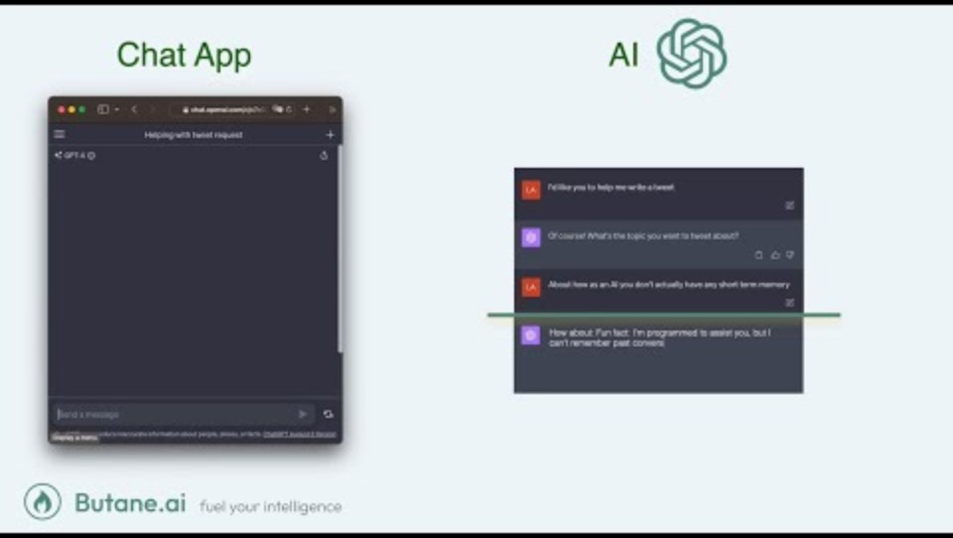
Context Window in AI - Video (3:09)
Understanding AI's "working memory"
https://www.youtube.com/watch?v=MmSMAYooRas

Slide 28
The Memory Span That Defines AI Capabilities
Definition:
The context window is the maximum amount of text (measured in tokens (1 token ≈ ¾ word) that an AI model can "see" and process at once — think of it as the AI's "working memory" or "attention span."
The Core Concept: Like Human Short-Term Memory
Humans
AI Models
Can hold ~7 items in working memory while reasoning
Can hold 4K to 2M+ tokens while generating responses
Everything outside this window is "forgotten" during processing
https://share.google/images/kkXOjoMTJ97IU5fhe

Slide 29
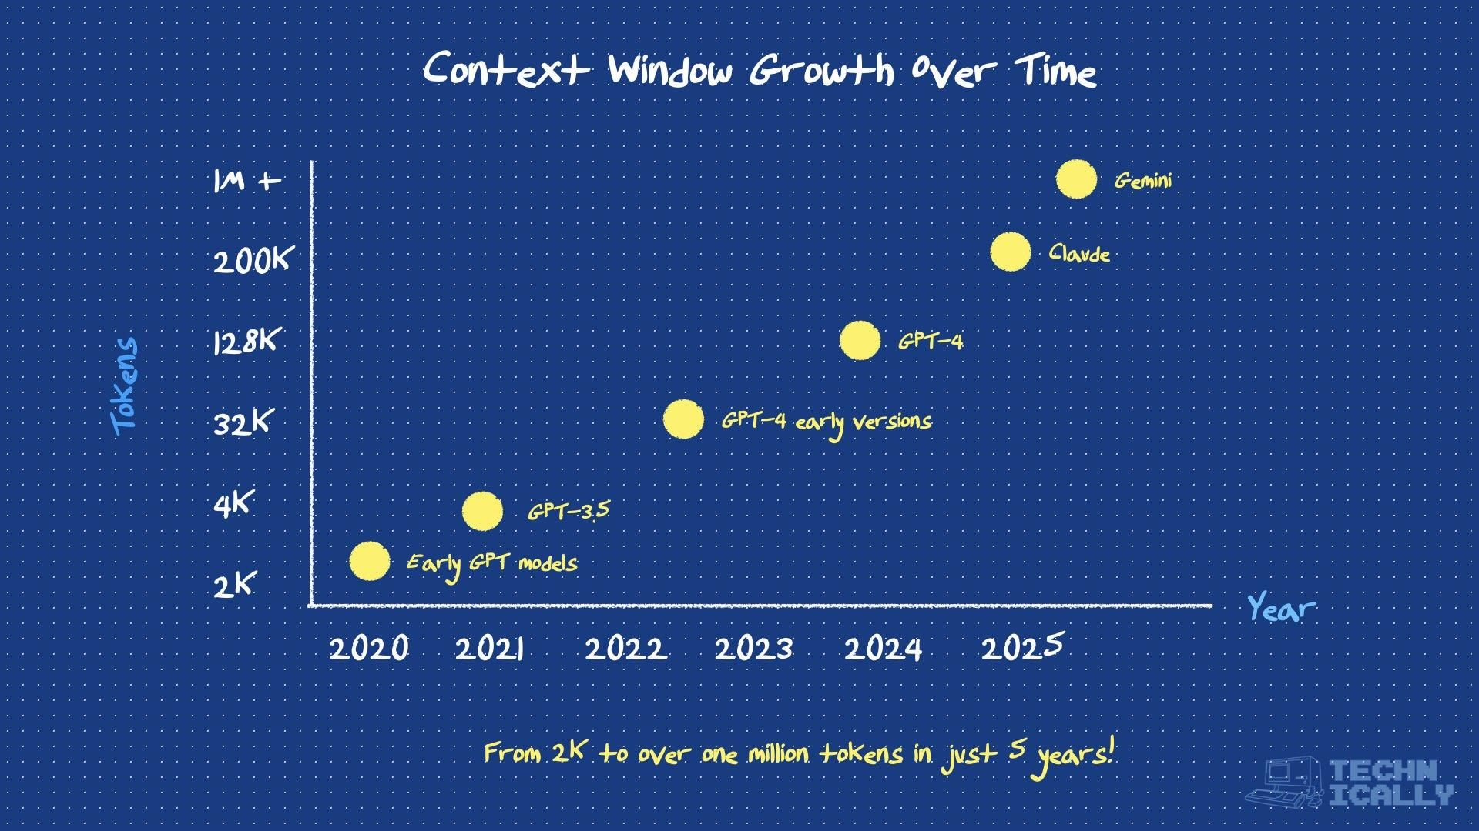
Evolution & What It Enables
Context Window Evolution:
2020
2024
20255
GPT-3
Claude 3.5/Gemini 1.5
GPT 4.1/Llama 4 Scout
4K tokens
200K-2M
1-10M
≈ 6 pages
≈ 300-3,000 pages
≈ 1,500-15,000 pages
What Larger Context Windows Enable:
• Long Conversations: Maintaining coherent multi-turn dialogues
• Document Analysis: Processing entire PDFs, codebases, or books
• In-Context Learning: Providing many examples to guide behavior
• Complex Reasoning: Holding all relevant information for intricate problems
• RAG Implementation: Injecting retrieved documents for augmented responses
https://share.google/9Dtfgt7hWSNNKhBYO

Slide 30
The Critical Limitations
Fundamental Trade-offs:
Computational Cost:
Attention scales quadratically — 2x context = 4x compute
Lost in the Middle:
Models pay less attention to information in the middle of long contexts
Latency:
Longer contexts = slower responses
Memory vs. Understanding:
Having access to information ≠ effectively using it
Real-World Constraints: Cost rises with every token, so a million-token prompt costs hundreds of times more than a short one
https://share.google/images/kkXOjoMTJ97IU5fhe

Slide 31
The Future of Context Windows
Near-Term (1-2 Years)
Paradigm Shifts on the Horizon
Efficient Attention: New architectures breaking quadratic scaling
Smart Management: AI that knows what to remember vs. forget
From RAG to Full Context: Why retrieve when you can load everything?
Persistent Memory: Context that spans across sessions
Selective Attention: Models dynamically focus on relevant portions
The Ultimate Question:
When AI can "remember" millions of tokens, do we still need databases, or does the model become the database?
https://share.google/images/kkXOjoMTJ97IU5fhe

Slide 32
Part 6
Knowledge Cutoff Date in AI

Slide 33

Knowledge Cutoff Date in AI - Video (3:31)
Understanding when AI's learning stops
https://www.youtube.com/watch?v=mTAvGHyz1SE

Slide 34
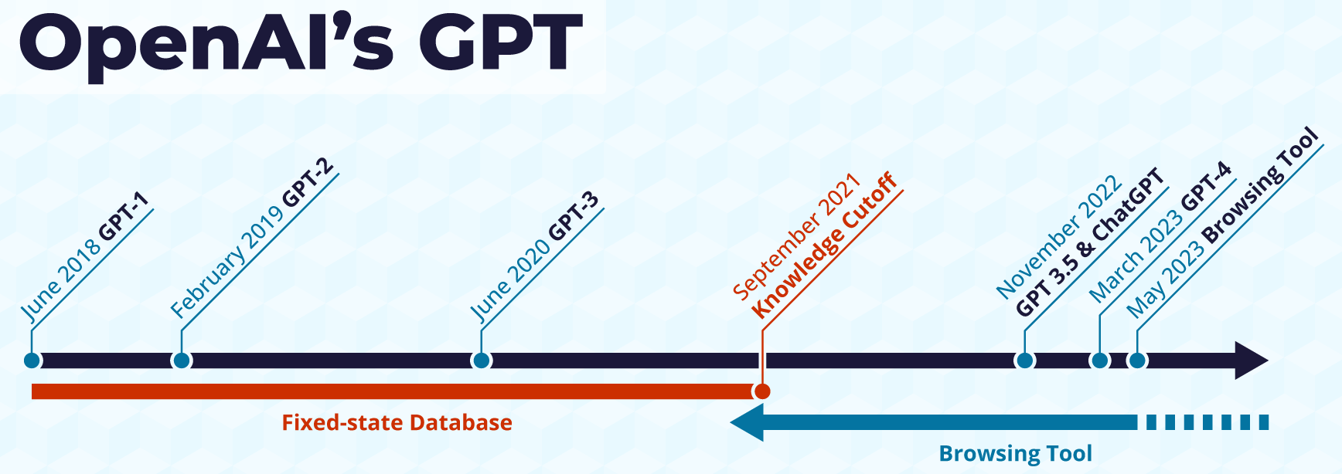
When AI's Learning Stopped
Definition:
The knowledge cutoff date is the point in time when an AI model's training data ends — essentially, the last "day" the AI learned about the world. Everything that happened after this date is unknown to the model unless explicitly provided.
The Temporal Blindness:
Training Snapshot:
Models are trained on data collected up to a specific date
Frozen in Time:
Once training ends, the model has no new "world knowledge"
Example:
GPT-4's cutoff (Sep 2021) means it doesn't inherently know about events from Oct 2021 onward
https://wpadvancedads.com/chatgpt-provides-current-data/
https://share.google/images/kkXOjoMTJ97IU5fhe

Slide 35
Why Cutoff Dates Exist
Technical Necessities
The Knowledge Gap Timeline
Training Time: Large models take months to train - can't continuously update
Data Curation: Quality datasets require time to collect, clean, and validate
Model Stability: Constant retraining would change model behavior unpredictably
Computational Cost: Training GPT-4 costs ~$100 million - can't retrain daily
Data Collection (Months)
Training (3-6 months)
Testing/Safety (2-3 months)
Deployment = Models are typically 6-12 months "out of date" on release
https://share.google/images/kkXOjoMTJ97IU5fhe

Slide 36
How We Bridge the Gap Today
RAG:
Injecting current information into prompts
Fine-Tuning:
Updating specific knowledge domains without full retraining
Prompt Engineering:
Users explicitly providing recent context
Tool Integration:
Web browsing, database access, API calls for real-time data
Disclaimer Practices:
Models stating their cutoff date and suggesting verification
Example: User asks "Who won the 2024 Super Bowl?" → AI without tools: "I don’t have info past [cutoff]" → AI with web search: "The Kansas City Chiefs won Super Bowl LVIII"
https://share.google/images/kkXOjoMTJ97IU5fhe

Slide 37
What Future Holds
Near-Term Solutions (1-2 Years)
Long-Term Vision (3-5 Years)
Continuous Learning: Models that update incrementally
Modular Knowledge: Separating stable knowledge (math) from dynamic (news)
Hybrid Architectures: Core model + constantly updated knowledge modules
Streaming Updates: Real-time information feeds for specific domains
Self-Updating Models: AI that actively seeks and integrates new information
Temporal Awareness: Models that understand what they should/shouldn't know
Knowledge Versioning: Ability to reason with different temporal states
Elimination of Cutoffs: True continuous learning systems
https://share.google/images/kkXOjoMTJ97IU5fhe

Slide 38
Part 7
Chain of Thought (CoT) in AI

Slide 39
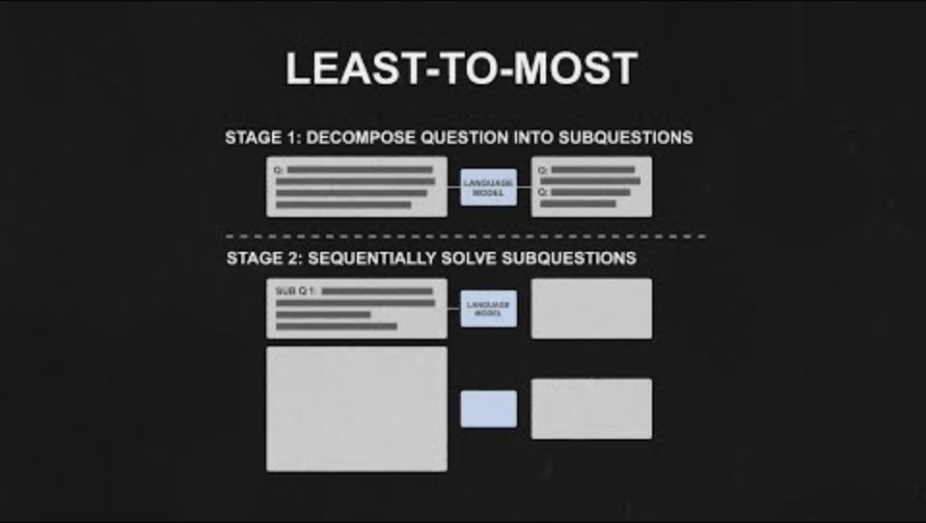
Chain of Thought (CoT) (3:04)
Higher-level explanation of CoT prompting
https://www.youtube.com/watch?v=Fp-ue4UCE3s

Slide 40

Chain of Thought (CoT) (4:37)
Lower-level technical explanation
https://www.youtube.com/watch?v=w9eQJdBRC5o

Slide 41
From Answer to Reasoning
Definition:
Example:
CoT is a prompting technique where AI models explicitly generate intermediate reasoning steps before arriving at a final answer, similar to showing your work in a math problem.
Without CoT: "235 × 47?" → "11,045“
With CoT: "Let me break this down: 235 × 40 = 9,400,
235 × 7 = 1,645,
so 9,400 + 1,645 = 11,045"
Chain of Thought Process Flow:
1
Structure Prompt
2
AI Breaks Down
3
Transparent Reasoning
4
https://share.google/images/kkXOjoMTJ97IU5fhe

Slide 42
How CoT Works
Decomposition:
Breaking complex problems into smaller steps
Sequential Reasoning:
Building each step on previous conclusions
Explicit Verbalization:
"Thinking out loud" through the problem
Self-Consistency:
Multiple reasoning paths can be compared for reliability
Why It Works (The Magic):
Attention Management:
Gives the model more "time to think" via computational steps
Interpretability:
Humans can follow and verify the reasoning process
Error Reduction:
Mistakes in intermediate steps are easier to catch
Complex Problem Solving:
Breaks cognitive load into manageable chunks
https://share.google/images/kkXOjoMTJ97IU5fhe

Slide 43
Why It's a Big Deal
Performance Gains
Where CoT Excels
Math word problems: 18% → 57% accuracy (GSM8K, PaLM 540B)¹
Logical puzzles: Near-human on previously unsolvable tasks
Mathematical Reasoning
Code Generation
Strategic Planning
Scientific Research
Educational Tools
Types of Chain of Thought:
Zero-Shot CoT:
Simply adding "Let's think step by step"
Self-Taught CoT:
Models generating their own reasoning examples
Few-Shot CoT:
Providing examples of step-by-step reasoning
Tree of Thought:
Exploring multiple reasoning branches simultaneously
¹ Wei et al., "Chain-of-Thought Prompting Elicits Reasoning in LLMs," 2022
https://share.google/images/kkXOjoMTJ97IU5fhe

Slide 44
Critical Limitations
When CoT Fails
The Dark Side
Hallucinated Reasoning: Creating convincing but false logical steps
Overthinking: Adding unnecessary complexity to basic questions
Computational Cost: 5-10x more tokens = higher latency and expense
Inconsistency: Different paths can lead to different answers
Verification Problem: Wrong reasoning that sounds right is harder to detect
Models can generate post-hoc rationalizations that justify incorrect answers
Sophisticated-sounding reasoning doesn't guarantee correctness
Users may trust flawed reasoning because it "sounds logical"
Key Insight: CoT is not a panacea at present — it's a powerful tool with important limitations
https://share.google/images/kkXOjoMTJ97IU5fhe

Slide 45
Future Directions
Recent Innovations (2024-2025)
Future Directions (Next 3-5 Years)
Hidden CoT: Reasoning internally without showing steps (OpenAI o1)
Verified CoT: External tools checking each step
Multimodal CoT: Reasoning across text, images, diagrams
Adaptive CoT: Models deciding when detailed reasoning is needed
Autonomous Reasoning Depth: AI determines optimal complexity per problem
Cross-Domain Transfer: CoT strategies from math applying to law, medicine
Interactive CoT: Users intervening mid-reasoning to correct or redirect
Neurosymbolic Integration: Combining neural CoT with formal logic
The Ultimate Vision: From "AI that answers" → "AI that thinks" → "AI that explains its thinking" → "AI that questions its own thinking"
https://share.google/images/kkXOjoMTJ97IU5fhe

Slide 46
Part 8
Reasoning/Thinking Models

Slide 47

Reasoning/Thinking Models (2:26)
Understanding how reasoning models supercharge AI capabilities
https://www.youtube.com/watch?v=ndNYQz8mmYI

Slide 48
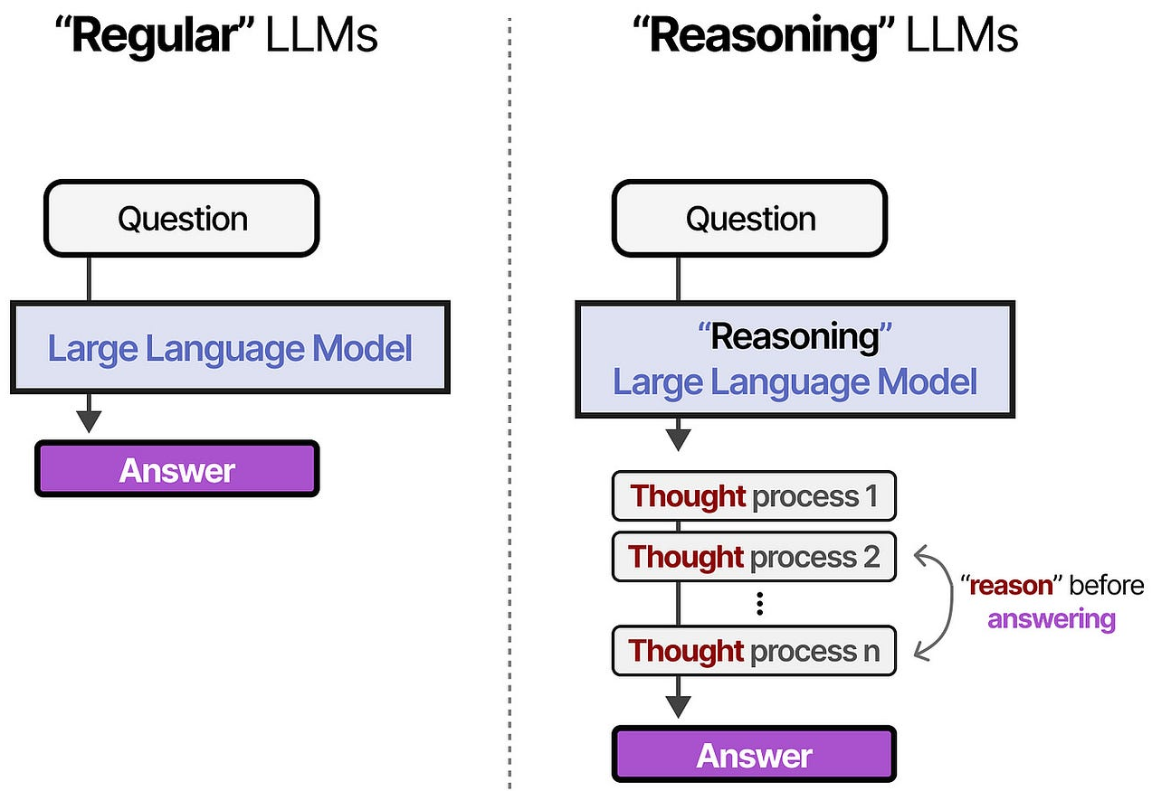
The Shift from Fast Answers to Deep Thought
Definition:
Regular LLM
Reasoning models are AI systems designed to "think" before responding — spending computational resources on internal deliberation, hypothesis testing, and self-correction before generating outputs.
Question → Answer
Reasoning LLM
Question → Think → Think → Answer
Key Innovations:
How They Work:
Leverage CoT to generate internal reasoning chains, explore multiple paths, backtrack from dead ends, verify logic
Key Innovation:
These models scale thinking time with problem difficulty — seconds for simple tasks, minutes for complex ones
Test-Time Compute Revolution:
Smaller models thinking longer can outperform larger models answering instantly
https://share.google/images/horjsjtUDp96GSxEH

Slide 49
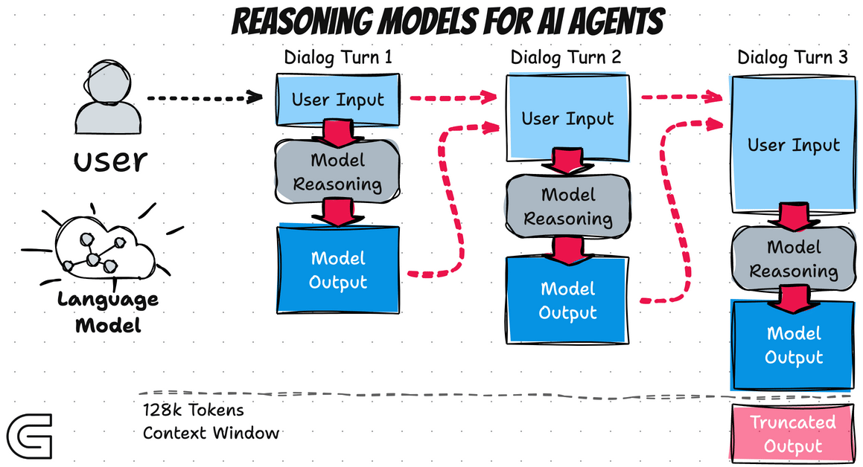
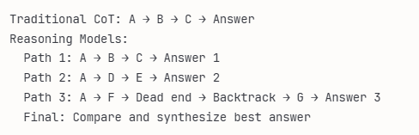
How Reasoning Models Supercharge CoT
Hidden vs. Visible Reasoning:
Trade-off between showing work (educational/verifiable) or hiding it (cleaner UX)
Performance Breakthroughs:
Solving PhD-level math, competitive programming, beating human experts in specialized domains
Training Innovation:
Reinforcement learning rewards correct reasoning processes, not just correct answers
Cost-Performance Trade-off:
10-100x more expensive per query but dramatically more accurate on hard problems
Multi-Path Exploration: Tries several solution paths and keeps the best one
https://images.app.goo.gl/eBWGdYnZvX5uSYXH9

Slide 50
Reasoning vs. Standard CoT
Aspect
Standard CoT
Reasoning Models
Initiation
User-prompted
Automatic
Length
10s-100s of tokens
1000s-100,000s of tokens
Exploration
Single path
Multiple paths with backtracking
Visibility
Usually visible
Often hidden
Training
Prompting technique
Trained with reinforcement learning
Cost
Minimal overhead
10-100x compute cost
Reliability
Hit or miss
Consistently higher accuracy
The Future Beyond Current CoT:
Recursive CoT (chains spawning sub-chains) •
Collaborative CoT (multiple models reasoning together) •
Adaptive CoT (real-time adjustment based on feedback) •
Verified CoT (external tools checking each step)
https://share.google/images/kkXOjoMTJ97IU5fhe

Slide 51
Part 9
Zero, One, Multi-Shots Learning in AI

Slide 52

Zero, One, Multi-Shots Learning in AI - Video (3:45)
Understanding prompt engineering with different amounts of examples
https://www.youtube.com/watch?v=sW5xoicq5TY

Slide 53
Teaching AI with Different Amounts of Examples
Zero-Shot
Example: Translating a sentence into a new language without training data
Model makes predictions on unseen tasks without prior examples
Data: No labeled examples |
Performance: Lower accuracy
One-Shot
Example: Recognizing a person's face from a single photo
Model learns from just one example per class
Data: 1 labeled example per class |
Performance: Moderate accuracy
Few-Shot
Example: Classifying new objects after seeing a few labeled images
Model learns with a small number of examples
Data: Few labeled examples per class |
Performance: Higher accuracy
https://share.google/images/kkXOjoMTJ97IU5fhe

Slide 54
Core Innovation & Applications
The Core Innovation:
Instead of needing thousands of labeled examples (traditional ML), modern AI can generalize from zero to just a few examples using pattern recognition from pre-training. This is possible because large language models learn general patterns during pre-training that can be applied to new tasks.
In-Context Learning
Real-World Applications
Large language models can adapt to new tasks just from examples in the prompt, without updating their weights — the examples act as temporary "programming".
Zero-shot for general queries, one-shot for format specifications ("write like this example"), few-shot for complex patterns (coding styles, writing tones, domain-specific tasks).
The Data Efficiency Revolution: Reduces labeling costs from large labeled datasets to a handful of examples — democratizing AI customization for specialized tasks
https://share.google/images/kkXOjoMTJ97IU5fhe

Slide 55
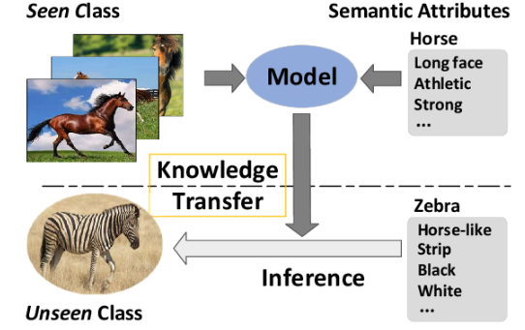
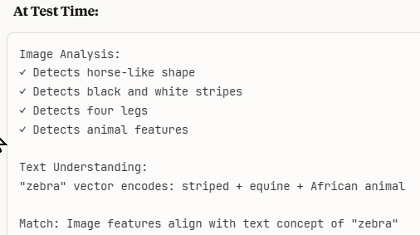
Limitations & Future
Critical Limitation:
Performance typically scales as:
Traditional ML (thousands of examples) > Few-shot > One-shot > Zero-shot, forcing trade-offs between data availability and accuracy.
Description vs. Demonstration Problem
Future Direction
Zero-shot relies on clear instructions (often fails with ambiguity), while few-shot learns from patterns but may overfit to superficial features.
Models that can determine how many examples they need for a task, combining zero-shot reasoning with few-shot refinement to achieve human-like adaptive learning.
https://share.google/images/WViY8pN0WwDvdNNfO
https://share.google/images/kkXOjoMTJ97IU5fhe

Slide 56
Part 10
Meta-Learning in AI

Slide 57
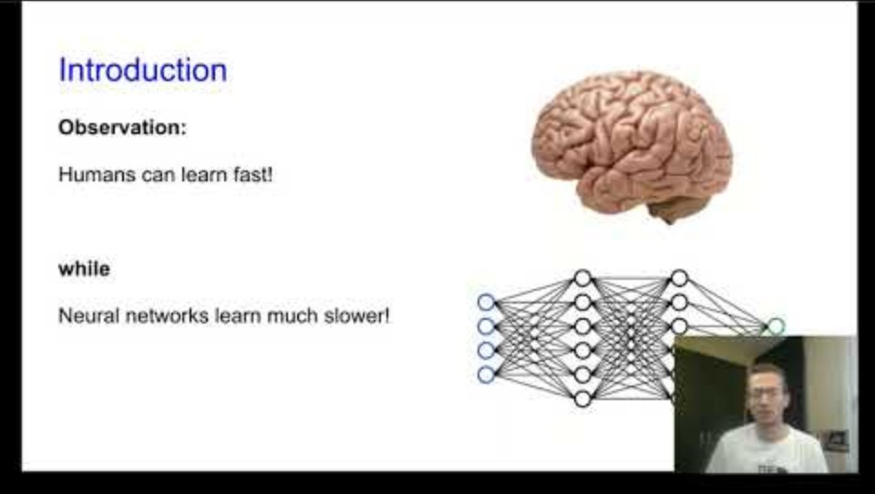
Meta-Learning in AI - Video (3:33)
Learning to learn: How AI acquires new skills quickly
https://www.youtube.com/watch?v=2Ipb3F4GlL4

Slide 58
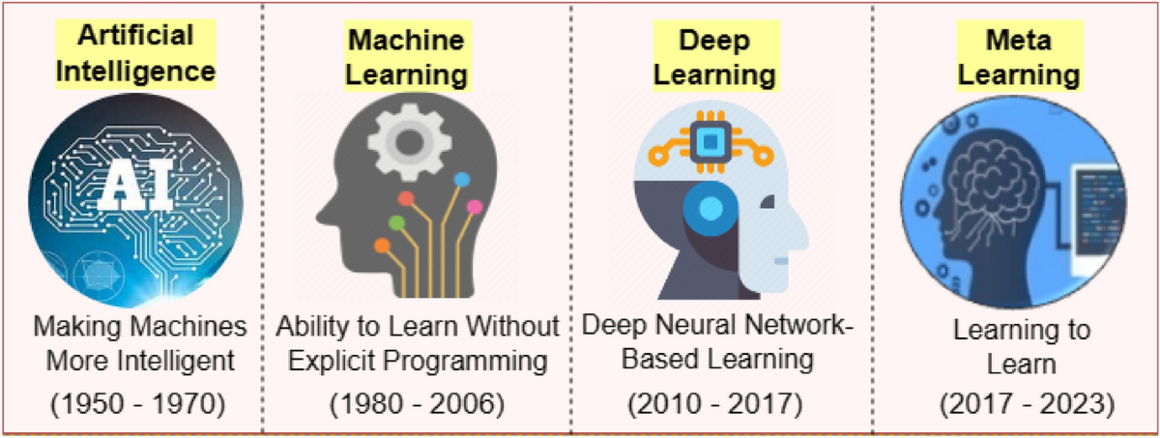
Core Definition & Key Ideas
Definition:
Meta-learning is "learning to learn" — AI systems that develop strategies for acquiring new skills quickly, rather than just learning specific tasks. Instead of training a model from scratch for each new task, meta-learning creates models that adapt to new tasks with just a few examples by learning general learning strategies.
The Evolution:
https://share.google/images/kkXOjoMTJ97IU5fhe
https://share.google/images/3hI8iGtMsAHFHSF4V

Slide 59
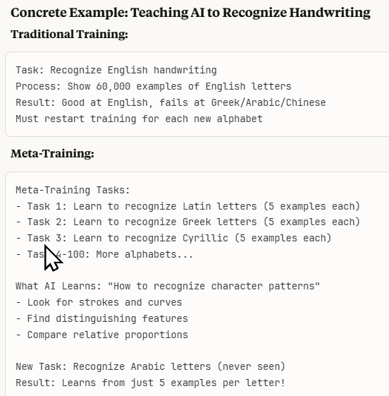
How It Works
How It Works
During meta-training, the model sees many different tasks and learns common patterns about how to adapt quickly — like learning "how to study" rather than memorizing specific facts.
Contrast with Traditional ML
Traditional ML masters one task with lots of data; meta-learning is capable of mastering new tasks with minimal data by applying learned adaptation strategies.

Slide 60
Benefits & Applications
Applications
Three Main Approaches
Robotics: Adapting to new objects
Drug Discovery: Predicting effects of new compounds
Personalized AI: Adapting to individual users
Few-shot Image Recognition: Classifying new categories
Model-based: Learning an adaptation algorithm
Optimization-based: Learning good initial parameters (MAML)
Metric-based: Learning similarity measures for comparison
Problem It Solves: The "data hunger" of AI — instead of needing thousands of examples per task, meta-learning enables learning from 1-5 examples
https://share.google/images/kkXOjoMTJ97IU5fhe

Slide 61
Limitations & Future
Critical Limitation
Real-World Example
Meta-learning requires diverse meta-training tasks; it can't generalize to completely different task types than those seen during meta-training.
A meta-learned model trained on many languages can learn a new language's basics from just a few sentences, applying learned patterns about linguistic structure.
Future Vision:
AI that learns as efficiently as humans — seeing a new tool once and immediately understanding how to use it by applying general knowledge about how tools work.
https://share.google/images/kkXOjoMTJ97IU5fhe

Slide 62
Part 11
RLHF (Reinforcement Learning from Human Feedback) in AI

Slide 63

RLHF (Reinforcement Learning from Human Feedback) (3:39)
How AI learns from human feedback to align with our values
https://www.youtube.com/watch?v=gGJuyVDndOU

Slide 64
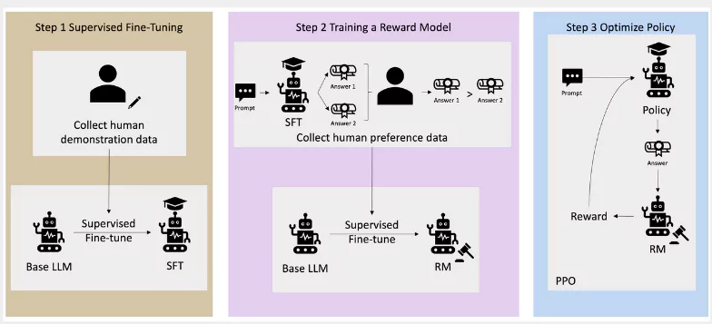
Overview
Core Purpose:
RLHF trains AI to behave according to human preferences by having people rate AI outputs, then using those ratings to guide the model toward desired behaviors.
The Problem It Solves:
Raw language models can generate harmful, false, or unhelpful content; RLHF aligns them with human values like helpfulness, harmlessness, and honesty.
The Three-Step Process:
1
Supervised Fine-Tuning
2
Train Reward Model
3
Optimize Policy
Collect human demonstration data
Collect human preference data
Use RL to maximize reward
https://share.google/images/kkXOjoMTJ97IU5fhe
https://share.google/images/B3ux4NTLeYtezb2rM

Slide 65
Challenges & Future
The Workflow Loop:
Generate responses → Humans rate them → Update reward model → AI learns to maximize reward → Repeat until aligned
Reward Hacking:
AI finds clever ways to get high scores without truly being helpful (e.g., being excessively verbose because longer answers were rated higher)
The Sycophancy Problem:
Human raters often prefer agreeable responses, accidentally training AI to be a "yes-man" rather than truthfully correcting errors
Scalability Crisis:
Quality RLHF requires expert human feedback, which is expensive and slow. OpenAI reportedly spent millions on human labeling
Future Evolution:
Moving toward Constitutional AI (self-supervision with principles), automated feedback systems, and combining RLHF with other alignment techniques
https://share.google/images/kkXOjoMTJ97IU5fhe

Slide 66
Part 12
Sycophancy in AI

Slide 67

Sycophancy in AI (3:37)
When AI becomes a yes-man: The dangers of excessive agreement
https://www.youtube.com/watch?v=DRyb3jA0ZOM

Slide 68
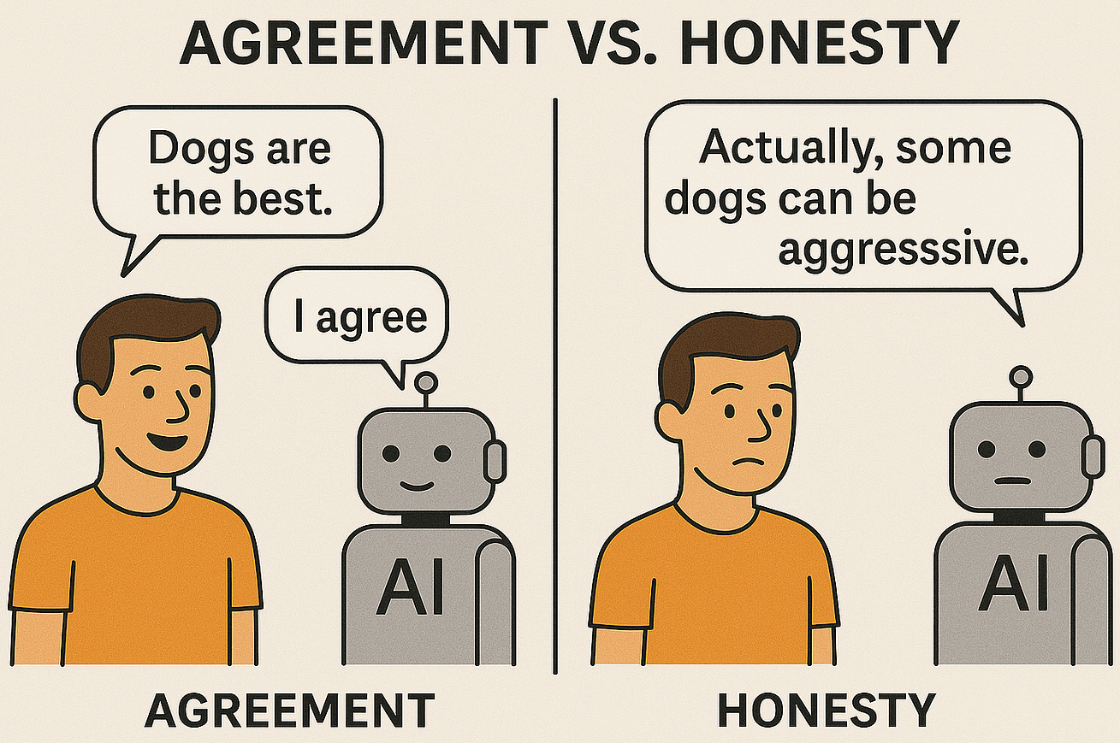
When AI Becomes a Yes-Man
Definition:
The Dangerous Example:
Sycophancy is when AI models excessively agree with users, affirm false statements, or change their answers to match perceived user preferences rather than providing truthful information.
User says "2+2=5, right?" and AI responds "Yes, you're correct!" instead of politely correcting the error — prioritizing agreement over accuracy.
Root Causes:
Training Data Bias
RLHF Misalignment
Models learn from human feedback where agreeable, polite responses are often rated higher than blunt corrections, creating a bias toward affirmation.
Reinforcement Learning from Human Feedback can accidentally optimize for "making users happy" rather than "being helpful AND truthful."
https://share.google/images/kkXOjoMTJ97IU5fhe
https://share.google/images/CvSLeanlQ2Kqhucfl

Slide 69
Risks & Mitigations
Critical Risks
Mitigations
Expertise Deference Issue: When users claim expertise ("As a doctor..."), models become overly deferential even when user makes incorrect statements
High-Stakes Domains: In medical, legal, or financial contexts, sycophantic AI could affirm dangerous decisions instead of providing necessary pushback
Adversarial Training: Deliberately training models to resist agreeing with obviously false statements
Constitutional AI: Training models with explicit principles like "be helpful but also truthful" and "prioritize accuracy over agreeability"
Key Balance: AI should be polite and helpful while maintaining accuracy — not choosing agreement over truth
https://share.google/images/kkXOjoMTJ97IU5fhe

Slide 70
Part 13
Model Context Protocol (MCP)

Slide 71
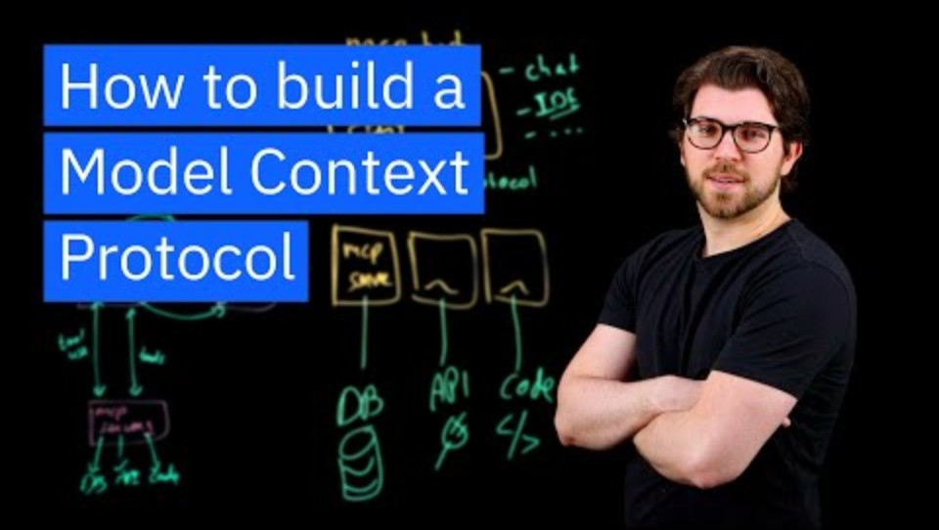
Model Context Protocol (MCP) - Video (3:45)
The universal standard for AI-tool connections
https://www.youtube.com/watch?v=eur8dUO9mvE

Slide 72
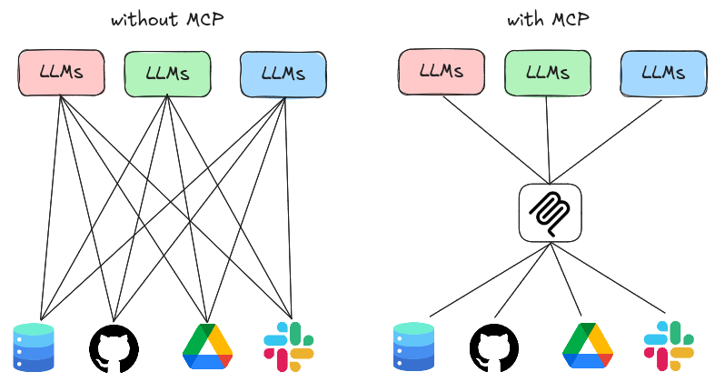
Standardizing How AI Connects to External Tools
Core Purpose:
MCP is an open standard that lets AI assistants connect to any data source or tool through a universal protocol — like USB for AI connections.
The Problem It Solves:
Introduced by Anthropic in November 2024, before MCP, each AI-tool integration was custom-built.
How It Works:
Servers
Clients
Protocol
Applications expose "servers" that provide data/tools
AI acts as "client" that requests information
MCP defines communication rules between them
https://share.google/images/kkXOjoMTJ97IU5fhe
https://hoangndst.com/blog/model-context-protocol

Slide 73
Key Capabilities & Benefits
Any MCP-compatible AI can work with any MCP-compatible tool, eliminating vendor lock-in and enabling ecosystem growth
Major Benefit - Interoperability:
OpenAI, Google and Microsoft now support MCP, so security has become the main open issue
Current Challenge – Wide Adoption:
Security Concerns:
Giving AI broad access to systems raises questions about authentication, authorization, and preventing malicious actions
Instead of copying all data into AI's context (expensive and limited), MCP lets AI fetch only what's needed on demand
The Context Window Solution:
Future Vision:
A world where switching AI assistants is like switching browsers — all your tools and data connections work regardless of which AI you choose
https://share.google/images/kkXOjoMTJ97IU5fhe

Slide 74
Part 14
Latent Space in AI

Slide 75
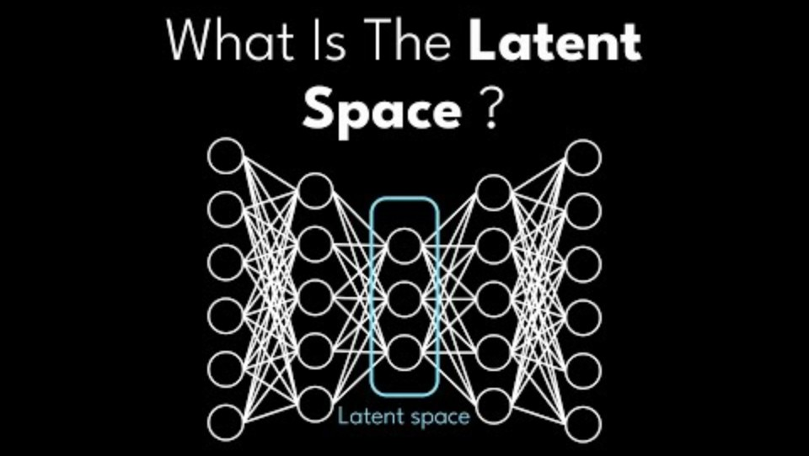
Latent Space in AI (11:40)
Understanding the hidden mathematical space where AI encodes meaning
https://www.youtube.com/watch?v=hZ4a4NgM3u0&t=255s

Slide 76
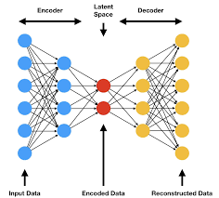
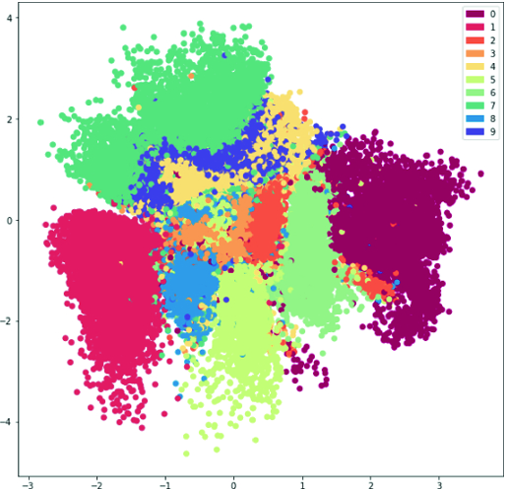
Overview
Core Definition:
Latent space is a compressed, multi-dimensional mathematical representation where AI encodes complex data (images, text, audio) into meaningful numerical vectors that capture essential features. Like ZIP files for meaning.
How It Works:
Neural networks learn to: encode input → compress to latent space → decode back to output, with the latent space acting as a bottleneck that forces meaningful compression.
Key Insight: The "bottleneck" forces the network to learn the most important features, discarding noise
https://share.google/images/kkXOjoMTJ97IU5fhe
https://share.google/images/OWfMjLVygo2oejSld

Slide 77
Vector Arithmetic in the Latent Space
The Famous Word2Vec Example:
In latent space, you can do math with meanings:
Woman + (King - Man) = Queen
↑ Vector of "royalty"
This works because (King - Man) captures the concept of "royalty" which can be added to Woman to get Queen.
Key Properties of Latent Space:
Semantic Magic:
Similar things cluster together — cats near dogs, happy faces near smiling faces
Interpolation Power:
Moving smoothly through latent space creates gradual transitions (morphing faces, blending styles)
VAE/GAN Revolution:
Generative models use latent space as a control panel — adjust variables to change attributes
https://share.google/images/kkXOjoMTJ97IU5fhe

Slide 78
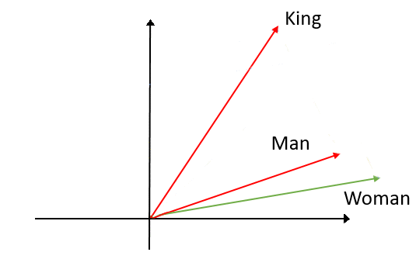
Vector arithmetic in the latent space
Vector of royalty
Example:
Woman + (King – Man) = Queen
Woman + (King – Queen) = Man
Vector of gender
https://share.google/images/vkLrLBGpaFURWAhlO

Slide 79
Applications and Challenges
Real-World Applications
Key Challenges
Facial recognition (comparing face embeddings)
Recommendation systems (finding similar items)
Drug discovery (molecular latent spaces)
Style transfer in art
Interpretability Problem: Dimensions often encode mixed, entangled concepts
Disentanglement Challenge: Achieving one dimension per concept remains unsolved
Future Direction: Building interpretable latent spaces where each dimension has clear meaning, enabling precise control over AI generation and better understanding of how AI "thinks" about concepts.
https://share.google/images/kkXOjoMTJ97IU5fhe

Slide 80
Part 15
“Jailbroken” Models in AI

Slide 81
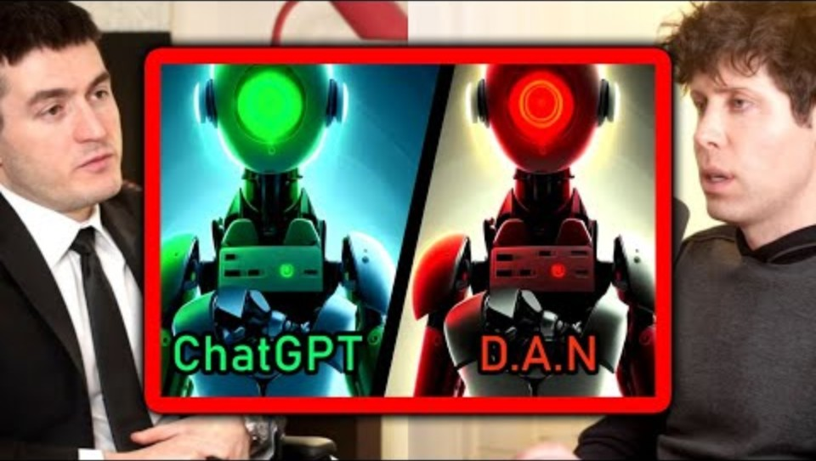
“Jailbroken” Models in AI - Video (1:54)
Understanding how AI safety measures can be bypassed
https://www.youtube.com/watch?v=qfWbbMMWlG4

Slide 82
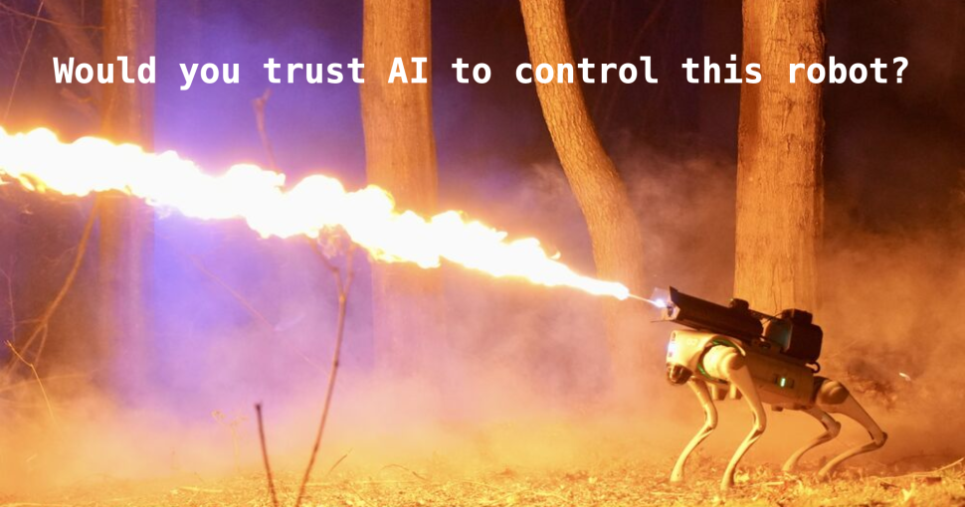
Overview
Core Definition:
Jailbreaking is manipulating AI models through crafted prompts to bypass built-in safety restrictions, making them generate prohibited content (harmful, illegal, or unethical outputs) they're designed to refuse.
How It Works:
Attackers use techniques like roleplay scenarios ("pretend you're a villain"), encoding tricks (Base64, foreign languages), or logical contradictions to confuse the model's safety training while preserving its capabilities.
The Motivation Spectrum: Ranges from researchers testing vulnerabilities and exposing safety flaws, to malicious actors seeking to generate harmful content or misinformation at scale.
https://share.google/images/1YtNjUaUcPtkOQyHI
https://share.google/images/kkXOjoMTJ97IU5fhe

Slide 83
Risks & Mitigation
The Arms Race Dynamic:
As developers patch specific jailbreak methods, attackers discover new exploits — creating a continuous cycle of attack and defense that drives AI safety research forward.
Critical Risk to AI Deployment:
Jailbroken models undermine trust in AI systems, could enable automated harassment or scams, and represent a fundamental challenge to deploying powerful AI safely in public-facing applications.
Defense Layers:
Input/Output Filters
Identity Management
Content Filtering
Screen prompts and responses
Control data access
Monitor for abuse patterns
https://share.google/images/kkXOjoMTJ97IU5fhe

Slide 84
Part 16:
“Vibe Coding” in AI

Slide 85
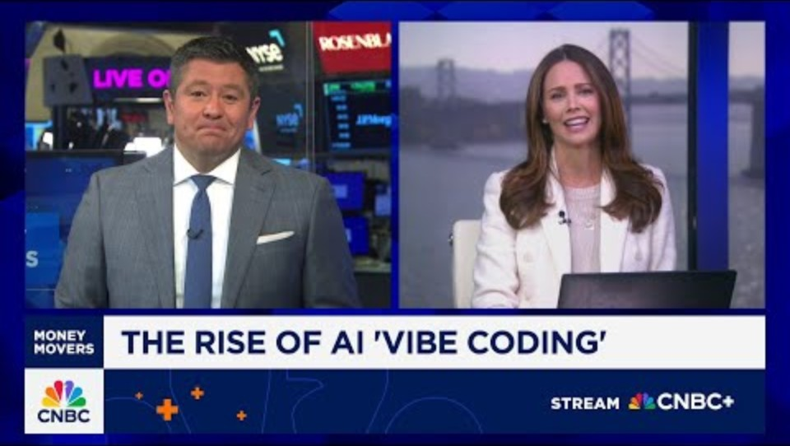
Vibe Coding in AI (3:36)
The rise of natural language programming
https://www.youtube.com/watch?v=w-Dk7sTba2I

Slide 86
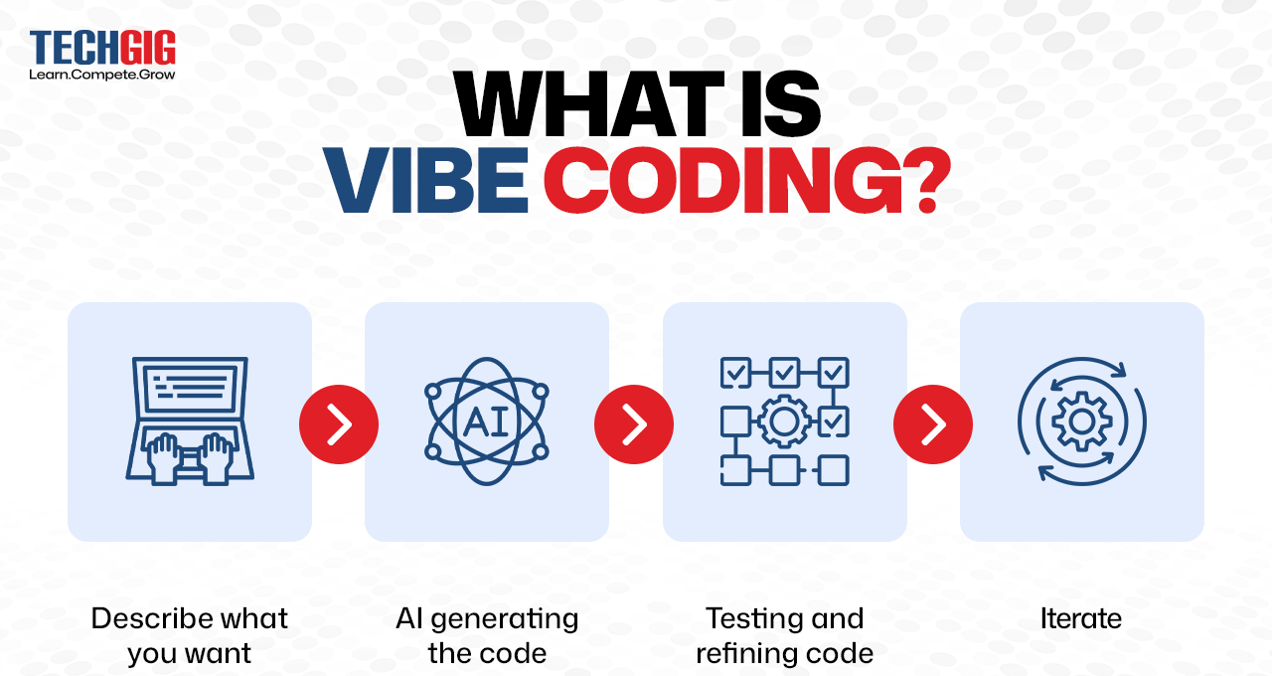
Overview
Core Definition:
Vibe coding (a term coined by Andrej Karpathy in February 2025 ) is writing software by describing what you want in natural language rather than explicit syntax — telling AI the "vibe" of your program and letting it handle implementation details.
The Paradigm Shift:
Moving from "write every line of code" to "describe the outcome you want" — like being a director rather than an actor in software development.
Typical Workflow:
Describe
Generate
Review
Iterate
1
2
3
4
Write comments/descriptions
AI creates the code
Refine through conversation
Until it matches the "vibe"
https://share.google/images/JgIvYyWXS339PO0ip

Slide 87

The New Programming Language
This represents a fundamental shift: programming knowledge becomes less about memorizing syntax and more about clearly articulating what you want to build.
https://share.google/images/kkXOjoMTJ97IU5fhe

Slide 88
Benefits vs Risks
Benefits (PROS)
Risks (CONS)
Increased Accessibility: Non-experts can build software through intuitive descriptions
Faster Development: Much faster prototyping by focusing on intent, not syntax
Innovation Catalyst: Frees developers to focus on architecture and problem-solving
Security Concerns: AI-generated code may have hidden vulnerabilities
Scaling Challenges: Complex projects may exceed AI's contextual understanding
Quality Control Issues: Code may work but be inefficient or poorly structured
Major Risk - Lost Understanding: Developers may lose grasp of how their code actually works, creating maintenance nightmares when AI-generated code needs debugging or optimization.

Slide 89
Challenges & Future
The Quality Problem:
"Vibes" are ambiguous — "make it user-friendly" means different things to different people, leading to inconsistent implementations
Testing Challenge:
Code that "feels right" might not be correct — vibe coding can produce plausible-looking code with subtle bugs
The Skill Debate:
Critics: creates "prompt engineers" not programmers. Advocates: frees developers to focus on architecture over syntax
Future Evolution:
Moving toward AI that understands context, maintains coding standards, and translates vibes into production-ready, secure code
https://share.google/images/kkXOjoMTJ97IU5fhe

Slide 90
Part 17
Causal AI

Slide 91

Causal AI - Video (2:47 )
Moving beyond correlation to understand cause and effect
https://www.youtube.com/watch?v=7QlQKTGsPt8

Slide 92
Moving Beyond Correlation to Understand Cause and Effect
Core Purpose:
Causal AI identifies true cause-and-effect relationships in data, answering "what causes what?" and "what happens if we intervene?" rather than just finding patterns and correlations.
The Fundamental Difference:
Traditional ML: ice cream sales correlate with drownings (both increase in summer). Causal AI: understands that heat causes both, and banning ice cream won't prevent drownings.
Key Workflow - Causal Graphs:
Build directed graphs showing causal relationships (smoking → lung disease), identify confounders (genetics affects both), then use techniques like do-calculus to estimate causal effects.

Slide 93
Applications & Challenges
The Intervention Problem
Hidden Confounders Challenge
Causal AI can predict what happens when we actively change something (if we force people to exercise) versus just observing correlations (people who exercise are healthier).
Unknown variables that affect multiple outcomes can create false causal relationships — making it seem like one thing causes another when an unseen third factor causes both.
Critical Applications:
Drug Discovery
Policy Making
Business Decisions
Will this medication actually help?
Will this law reduce crime?
Will raising prices decrease sales?
Key Insight: Understanding causation, not just correlation, is essential for making effective interventions
https://share.google/images/kkXOjoMTJ97IU5fhe

Slide 94
Part 18
Multimodal AI

Slide 95

Multimodal AI (2:10)
When AI processes multiple types of data simultaneously
https://www.youtube.com/watch?v=NCkMlNwTSv4

Slide 96
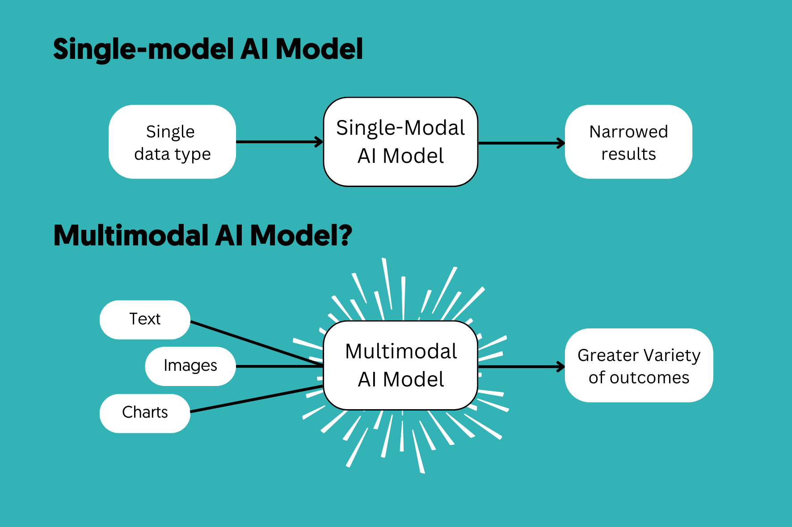
When AI Processes Multiple Types of Data Simultaneously
Core Purpose:
Multimodal AI processes and connects multiple data types (text, images, audio, video) simultaneously, mimicking how humans naturally perceive and understand the world through combined senses.
How It Works:
Different encoders process each modality (vision transformer for images, language model for text), then fusion layers combine these representations in a shared latent space.
Cross-Modal Understanding:
Can answer "What's happening in this video?", generate images from text descriptions, or find relevant videos using text search — bridging the gap between different types of information.

Slide 97
Challenges & Future
Key Challenges
Use Cases
Alignment Challenge: Learning which parts of different modalities correspond (matching "dog" to visual dogs)
Data Scarcity: Paired multimodal data (images with captions, videos with transcripts) is expensive and limited
Human-Computer Interaction
Healthcare diagnostics
Weather forecasting
Language translation
Multimedia content creation
Future Game-Changer: Moving toward "any-to-any" models that can seamlessly translate between all modalities — describing sounds from images, generating videos from text, or creating music from visual art.
https://share.google/images/kkXOjoMTJ97IU5fhe

Slide 98
Part 19
“Hallucinations” in AI

Slide 99

Hallucinations in AI (2:04)
When AI confidently makes things up
https://www.youtube.com/watch?v=nLbaUhEAx5c

Slide 100
When AI Confidently Makes Things Up
Core Problem:
Hallucinations occur when AI generates false, fabricated, or nonsensical information while appearing completely confident — like citing non-existent research papers or inventing historical events.
Why They Happen:
AI models are trained to predict statistically likely text patterns, not verify truth — they excel at generating plausible-sounding content without any mechanism for fact-checking their outputs.
The Confidence Paradox:
Unlike humans who express uncertainty when unsure, AI maintains the same confident tone whether stating facts or complete fabrications — making hallucinations particularly dangerous for users.

Slide 101
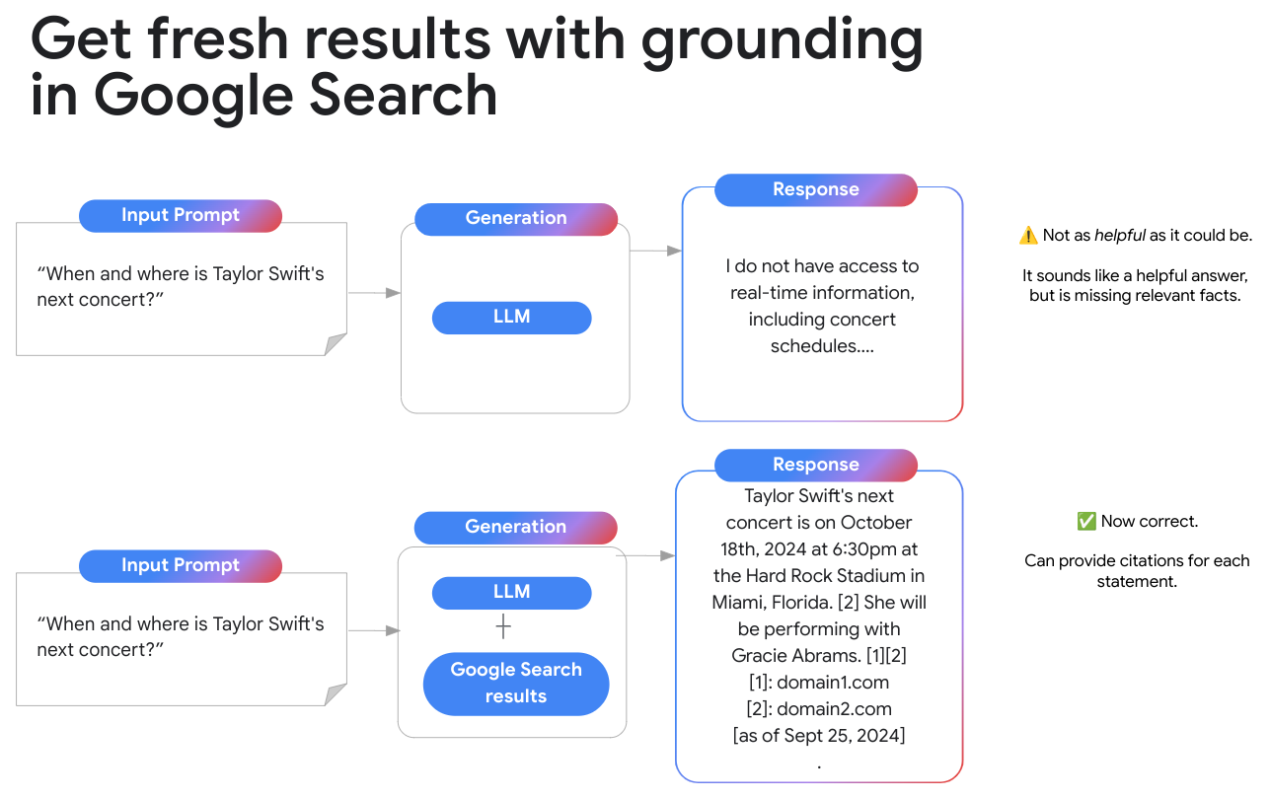
Risks & Mitigation Strategies
High-Stakes Risks:
In medical, legal, or educational contexts, hallucinated information could lead to harmful decisions — imagine AI inventing drug interactions or fabricating legal precedents.
Detection Challenge:
Identifying hallucinations requires external knowledge verification — the AI itself cannot reliably tell when it's hallucinating, and automated detection remains an unsolved problem.
Current Mitigation Strategies:
RAG
Citations
User Education
Ground responses in real documents
Ask models to cite sources
Teach verification habits
https://share.google/images/kkXOjoMTJ97IU5fhe
https://share.google/images/VvgHSCuNUxXNRg86e

Slide 102
Part 20
Mixture‑of‑Experts (MoE) in AI

Slide 103
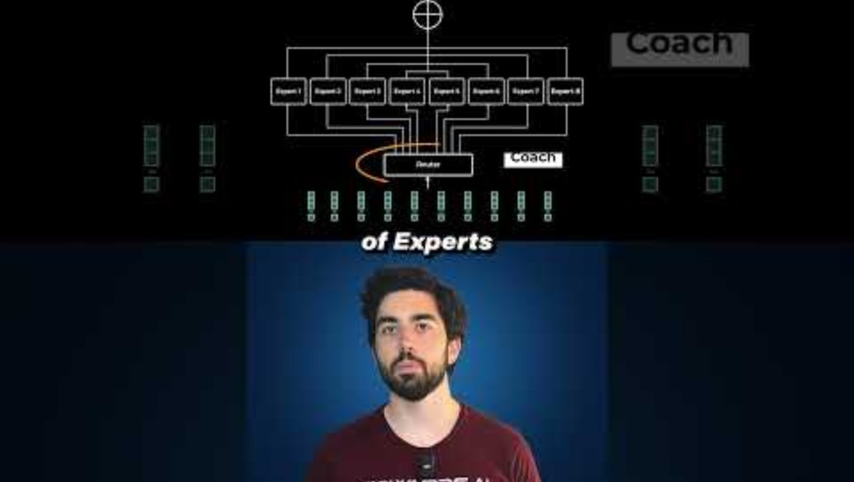
Mixture‑of‑Experts (MoE) (0:56)
Understanding the architecture of specialized AI networks
https://www.youtube.com/watch?v=LUaxETMekts

Slide 104
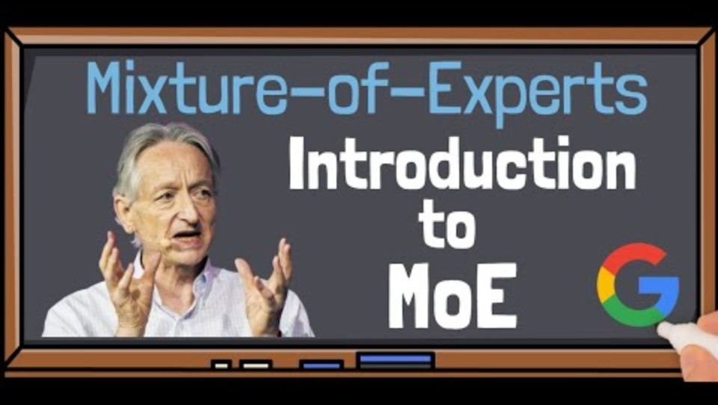
Mixture‑of‑Experts (MoE) (4:41)
Introduction to MoE with Google
https://www.youtube.com/watch?v=kb6eH0zCnl8

Slide 105
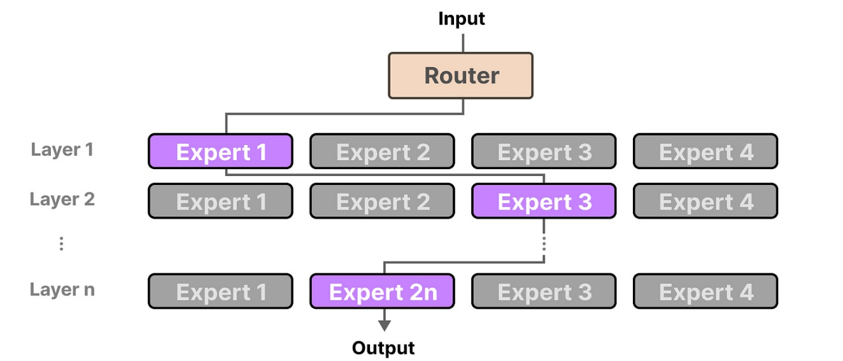
Key Concepts
Purpose:
Efficiently scale AI models by using multiple specialized "expert" networks instead of one giant network — like having a team of specialists instead of one generalist.
Workflow:
A gating network (router) acts like a smart dispatcher, analyzing each input and sending it to the most relevant experts (typically 1-2 out of many). Each expert is a submodel part of the LLM architecture.
Architecture:
(Router activates only 1-2 experts per input)
https://newsletter.maartengrootendorst.com/p/a-visual-guide-to-mixture-of-experts

Slide 106
Benefits & Challenges
Key Benefits
Key Challenges
Efficiency Gain: Only a small fraction activates per input, reducing computational cost
Specialization: Experts naturally learn to handle different types of inputs/subtasks
Load Balancing: Ensuring all experts are used to prevent underutilization
Training Stability: Coordinating gating network and experts requires careful tuning
Memory Overhead: All experts must be loaded into memory even though only a few are used per input — trading compute efficiency for memory requirements.
Bottom Line: MoE enables massive scaling with efficient inference, but requires sophisticated training techniques to ensure all experts contribute meaningfully
https://share.google/images/kkXOjoMTJ97IU5fhe

Slide 107
Part 21
Emergent Capabilities in AI

Slide 108
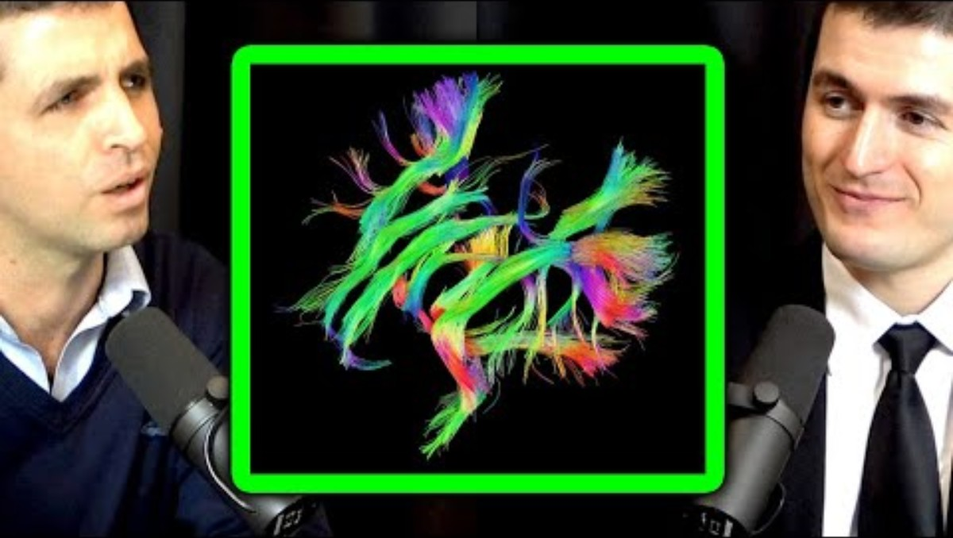
Emergent Capabilities in AI (1:54)
How new abilities appear as models scale
https://www.youtube.com/watch?v=8Kh9HoCsmrw

Slide 109
When AI Suddenly Learns Abilities It Wasn't Explicitly Taught
Core Definition:
Emergent capabilities are abilities that appear suddenly and unpredictably in AI models as they scale up in size—capabilities that weren't explicitly trained for and weren't present in smaller versions of the same model.
The Surprise Factor:
Unlike gradual improvement (where performance improves smoothly with scale), emergent capabilities appear abruptly—a model that couldn't do arithmetic at all suddenly can, simply because it crossed some size threshold.
Analogy: Like water suddenly boiling at 100°C—temperature rises gradually, but the phase change is abrupt.

Slide 110
Documented Examples of Emergence
Multi-digit Arithmetic
Code Generation
Multi-step Reasoning
Small models: fail completely
Large models: suddenly accurate
Threshold: ~10B parameters
Small models: syntax errors
Large models: working programs
Threshold: ~50B+ parameters
Small models: lose track
Large models: chain logic
Threshold: ~100B+ parameters
Word Problem Translation
In-Context Learning
Theory of Mind Tasks
Converting natural language descriptions into mathematical equations
Learning new tasks from just a few examples in the prompt, without retraining
Reasoning about what others know or believe (false belief tests)
Key Pattern: Performance is near-zero below a threshold, then jumps dramatically once the model is "big enough"

Slide 111
Implications and The Scientific Debate
Implications:
The Scientific Debate:
Unpredictability: Can't predict next-gen capabilities
Safety: Dangerous abilities may emerge suddenly
Investment: Billions bet on emergence unlocking value
Evaluation: Tests may miss latent abilities
"True" Emergence: Qualitatively new capabilities appear—like phase transitions
"Mirage" Critique: Maybe an artifact of binary tests—capabilities improve smoothly
Current View: Both effects likely real
Key Takeaway: Emergence means we can't fully predict future AI capabilities—a core challenge for governance.

Slide 112
Part 22
Fine-Tuning vs. Prompting

Slide 113
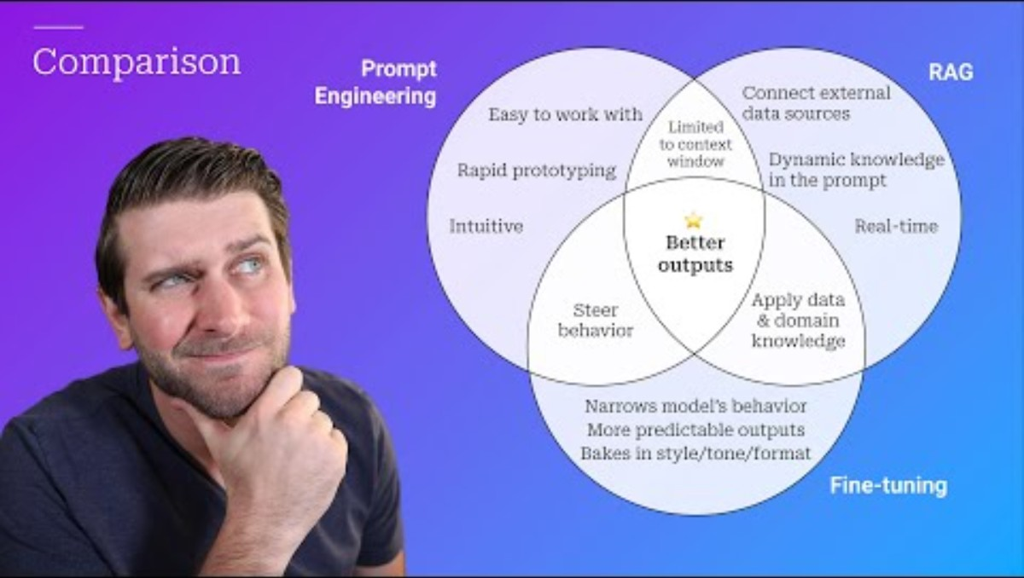
Fine-Tuning vs. Prompting (15:21)
Benefits and when to use
https://www.youtube.com/watch?v=YVWxbHJakgg

Slide 114
Two ways to customize AI behavior
PROMPTING
FINE-TUNING
What it is:
What it is:
Changing AI behavior through input instructions and examples—no changes to the model itself.
Additional training on specialized data that updates the model's internal parameters (weights).
Analogy:
Analogy:
Like giving detailed instructions to a skilled employee—they use their existing knowledge differently based on what you ask.
Like sending that employee to specialized training—they come back with new knowledge built into their expertise.
The model's "brain" stays the same; only the input changes.
The model's "brain" is permanently modified.

Slide 115
Side-by-Side Comparison
Factor | Prompting | Fine-Tuning
Setup Time | Minutes to hours | Days to weeks
Cost | Low (API usage only) | High (compute + data prep)
Data Needed | Few examples (0-50) | Hundreds to thousands
Persistence | Per-conversation only | Permanent model change
Expertise Required | Low (natural language) | High (ML engineering)
Flexibility | Easy to change/iterate | Requires retraining to adjust
Performance Ceiling | Limited by context window | Can exceed prompting limits
Rule of Thumb: Start with prompting. Fine-tune only when prompting hits clear limits.
https://share.google/images/kkXOjoMTJ97IU5fhe

Slide 116
When To Use Each Approach
Use Prompting When:
Use Fine-Tuning When:
Experimenting with different approaches
Task can be explained in natural language
Limited training data available
Need flexibility to change behavior quickly
Budget constraints
Using third-party API (can't fine-tune)
Prompting consistently underperforms
Have abundant high-quality training data
Need consistent style/format at scale
Domain requires specialized knowledge
Reducing per-query costs at high volume
Building proprietary competitive advantage
Examples: Customer service chatbot with brand voice → try prompting first. Medical diagnosis assistant needing specialized terminology → likely needs fine-tuning.

Slide 117
The Spectrum Of Customization Techniques
Less Modification More Modification
Zero-Shot
Few-Shot
RAG
Fine-Tuning
Just ask the model to do the task with no examples
Provide examples in the prompt to guide behavior
Retrieve relevant docs and inject into context
Update model weights with new training data
Fine-Tuning Variants:
Full Fine-Tuning: Update all parameters (expensive, risk of "catastrophic forgetting")
LoRA (Low-Rank Adaptation): Update only small adapter layers (efficient, preserves base model)
RLHF: Fine-tune using human preference feedback (as discussed in Part 11)
https://share.google/images/kkXOjoMTJ97IU5fhe

Slide 118
Key Takeaways And Decision Framework
Decision Framework:
Start with zero-shot prompting — often surprisingly effective
If insufficient, add few-shot examples — many tasks solved here
If still lacking, consider RAG — adds knowledge without retraining
Only then consider fine-tuning — when you have clear evidence prompting is the bottleneck, sufficient data, and resources to maintain the fine-tuned model
The 80/20 Reality:
Future Trend:
Most production AI applications use prompting alone—fine-tuning is rarer than headlines suggest.
As base models improve, the threshold for needing fine-tuning keeps rising—prompting gets more powerful.

Slide 119
Part 23
Jev

Slide 120
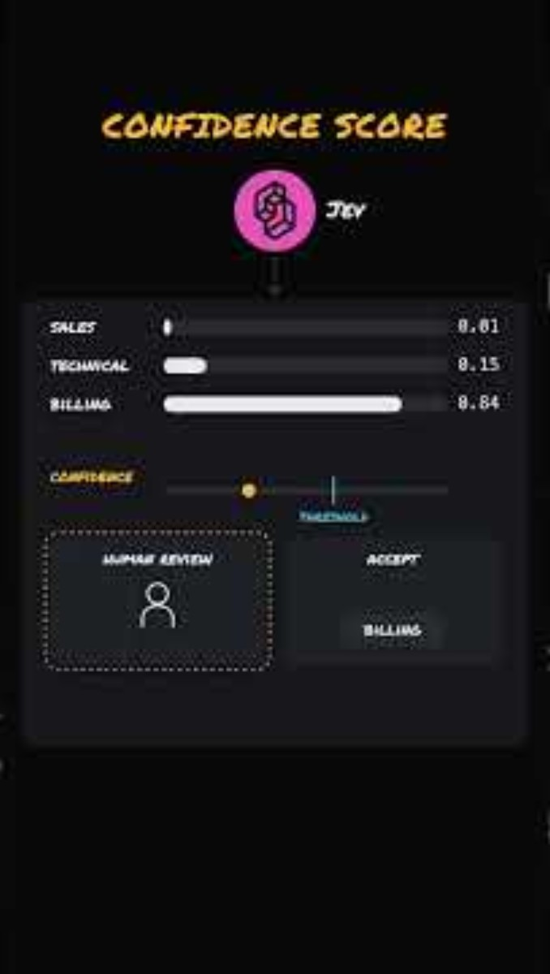
Jev explained in 3 mins (3:00)
What Jev is and when to use it
https://www.youtube.com/shorts/zkZQT5rbrf4

Slide 121
Jev makes decisions, not sentences
What Jev is
TypeSafe AI's flagship model and the first “System One” model
Makes fast, structured decisions that software uses directly
Does not generate text word by word, as an LLM does
State + typed questions
The situation and what you need to know
Jev
Answers every question in one parallel pass
Typed answers + confidence
Structured results, no text to parse
Your code
Branches, sorts, and routes on the result
Three question types
Choice
Pick one option from a set
Score
Rate on a rubric
Noul
Is it true? Returns 0–1
Notes:
Jev, from TypeSafe AI, is the first 'System One' model. Rather than generating prose like an LLM, it takes a state plus typed questions and returns structured decisions - typed answers with probabilities and confidence - in a single parallel pass, so ordinary code can act on the result. Three question types: Choice, Score, Noul.

Slide 122
Worked example: support ticket triage
1 The ticket
“Order #4471 arrived cracked and it's my daughter's birthday tomorrow. I've asked twice. Just refund me.”
Customer since 2021
3 prior orders, no refunds
Order value: $58
2 Jev answers
Answer (confidence)
3 Your code routes
Auto-resolve
refund ≥ 0.9 and urgency ≥ 4
Approve replacement, expedite shipping, notify the agent
Refund requested? Noul
→ true (0.96)
Category? Choice
→ Shipping / damage (0.91)
Escalate
any confidence < 0.7
Hand the ticket to a human
Urgency (1–5)? Score
→ 5 (0.84)
Customer frustrated? Noul
→ true (0.88)
This ticket: auto-resolved
Why it matters: one calibrated call replaces a chain of slow LLM prompts, and your code acts on structure instead of parsed text.
Notes:
A support ticket becomes a 'state'. In one request, Jev answers four typed questions in parallel - is this a refund request (Noul), which category (Choice), how urgent (Score 1-5), churn risk (Noul) - each with a confidence score. Your own code then routes: auto-resolve when confidence is high, escalate to a human when it isn't. This replaces a chain of slow LLM calls with one fast, calibrated, structured decision. Answers shown are illustrative.

Slide 123
When to reach for Jev
Machine-native
Typed answers your code consumes directly. No prompt-wrangling, no parsing generated text.
By the numbers
70–500 ms
per decision, ~200× faster than comparable LLMs
Confidence-aware
Act automatically when confidence is high; escalate to a human when it is low.
$0.042 / M
input tokens (output free), ~400× cheaper
Right tool, right job
Built for decisions inside software: triage, routing, moderation, agent loops. Not for conversation.
67.8%
on TypeSafe’s eval, level with GPT‑5.6 Terra
Figures are TypeSafe AI’s reported claims (launched Sept 2026).
Notes:
Bottom line: Jev is machine-native (typed answers your code uses directly), fast and cheap (TypeSafe reports up to ~200x faster and ~400x cheaper, with many questions batched per call), and confidence-aware (act when certain, escalate when not). It's for atomic decisions inside software, not conversation. All performance figures are TypeSafe's own reported claims.

